Slide 1
INCOSE IW 2012 MBSE Workshop INCOSE MBSE Initiative Methods and Metrics Activity
John C. Watson
Principal Member of Engineering Staff
Lockheed Martin, MS2 Moorestown
john.watson@lmco.com

Slide 2
Methodologies
Goal – Provide the INCOSE Community with a survey of available MBSE Methodologies
Foundational work based on 2008 paper by Jeff Estefan
Survey of Model-Based Systems Engineering (MBSE) Methodologies
Additional methodologies have been added and updated

Slide 3
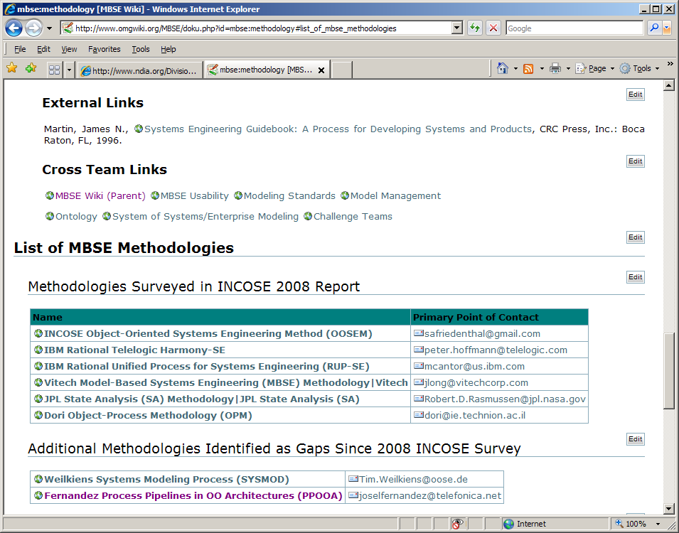
List of MBSE Methodologies

Slide 4
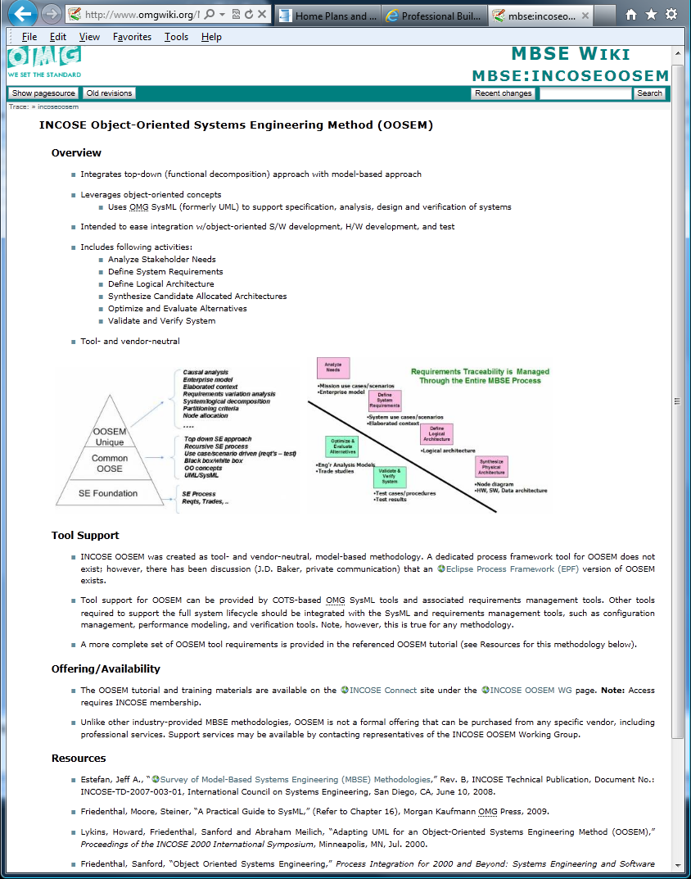

Slide 5
Metrics - ROI
Lack of ROI Information
MBSE Barrier to Change
Understand Risk and Benefits of change
Understand Cost of change and ROI
Goal – To provide a survey of industry papers/references that:
Justified a transition to MBSE
Highlight some lessons learned

Slide 6
Metrics - ROI
Metrics Information few and far between
Sensitive or Proprietary
Simply not collected or published
“Apples to Apples” comparison difficult to find
Survey to date includes;
14 references collected
Include both Anecdotal and Quantitative Data
Some are Software focus

Slide 7
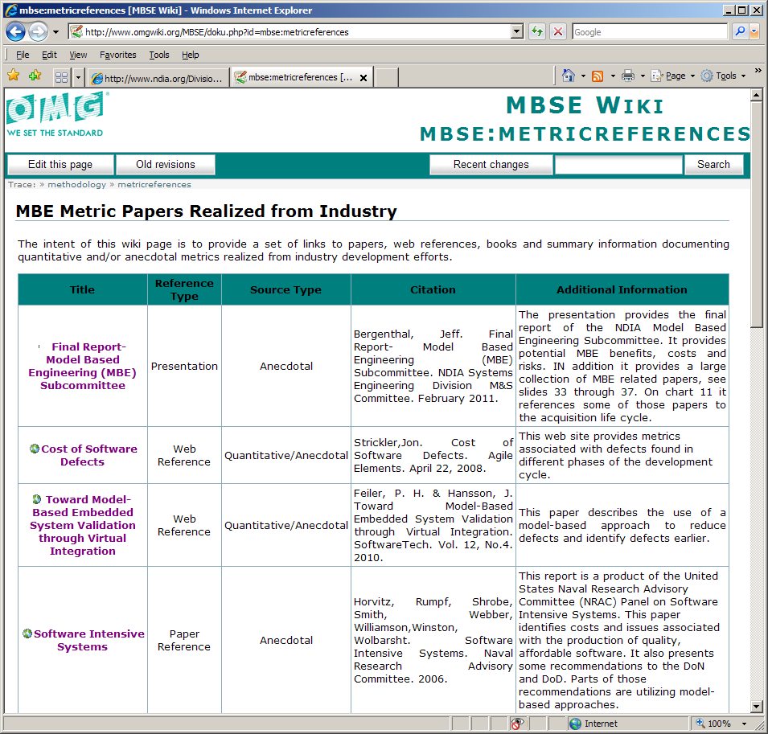
MBE Metric Papers - Sample

Slide 8
Collecting Model Metrics
How does an System Architectural Model Contribute?
Contains the most current behavior, structure, requirements and parametric model elements
Provides objective evidence of Architecture and Design Artifacts
Not just subjective data from human driven assessments
Provides an environment for “Continuous Assessment”
Not just at the design maturity gates

Slide 9
Collecting Model Metrics
To support Program and Engineering Management
To measure progress
To measure quality
To measure complexity
To measure Cost
To support day to day model maintenance
Collect, Track and Trend
If You Can’t Measure It, You Can’t Manage It

Slide 10
Methods and Metrics - Going Forward
Need your help
Know of any Methodologies that should be posted?
Know of any metrics references/papers/links worth sharing?
If so, please contact me

