Slide 1
INCOSE Digital Artifacts Challenge Team
Philomena Zimmerman
Office of the Deputy Assistant Secretary of Defense for Research and Engineering
February 21, 2018

Slide 2
Topics
Overview of the Digital Artifacts Challenge Team
Review Workshop Activities
Next Steps

Slide 3
Digital Artifacts Challenge Team History
The International Council on Systems Engineering’s (INCOSE) International Workshop (IW) 2017 highlighted the need to establish an accepted set of Digital Artifacts to help the Systems Engineering (SE) practice transform to a more model-based discipline
Participants made requests to the INCOSE SE Transformation Team and the Model-Based Systems Engineering (MBSE) Initiative to start a more enduring “Digital Artifacts” effort
INCOSE SE recommended standing up a Digital Artifacts Challenge Team
Digital Artifacts Challenge Team is a result of INCOSE IW 2017 activities

Slide 4
Digital Artifact Challenge Objectives
Advance understanding & acceptance of a finite set of Digital Artifacts that industry can institutionalize
Identify and describe Digital Artifacts required to support the entire life cycle of a system or product to include:
Engineering activities
Life cycle phase transition
Manufacturing process
Collaboration between domains
Business processes
Etc.

Slide 5
Digital Artifacts Concepts
Digital Artifacts (DAs) are produced within, or generated from, the activities with a digital engineering ecosystem.
These artifacts provide data, algorithms and/or processes used to visualize, communicate, deliver information and knowledge to stakeholders, and are used to aid in making decisions.
Digital artifacts can be thought of as those elements that describe any aspect of a system (physical, functional, analytical) and which can be executed in, or used in execution in a computing environment.
Shift the emphasis in Systems Engineering away from documents and towards digital artifacts.

Slide 6
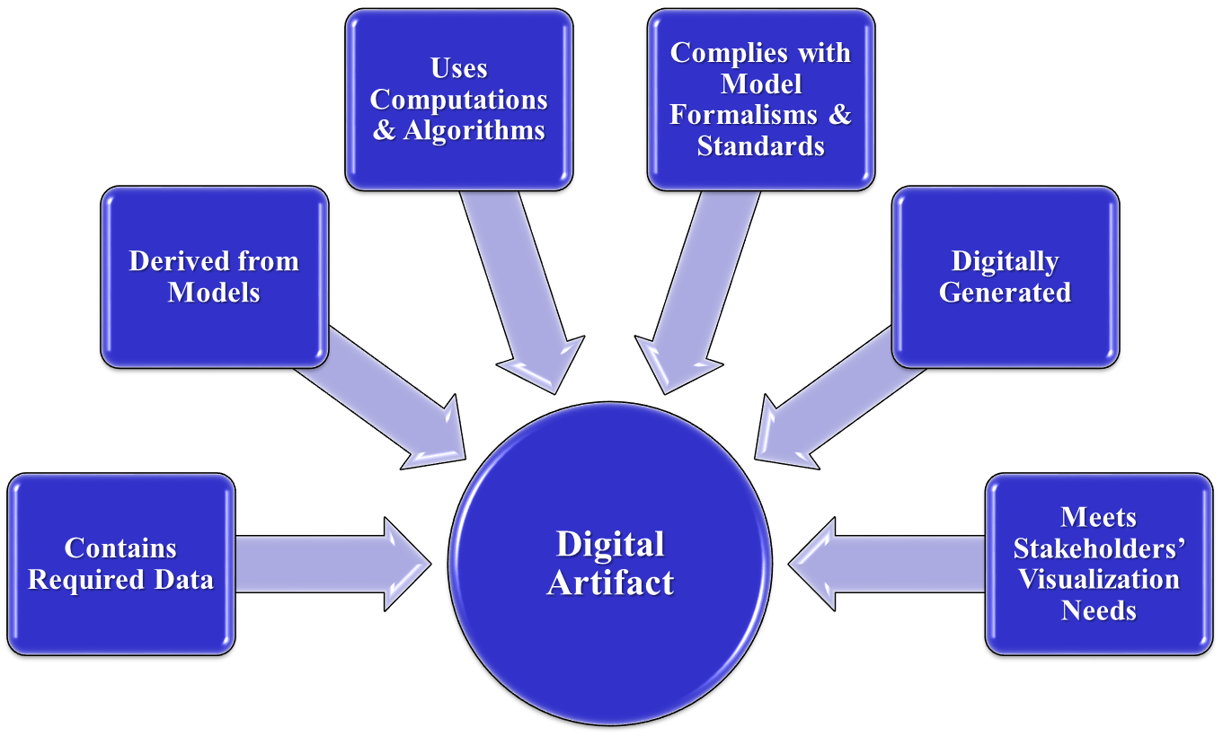
Generic Digital Artifact Concepts
Initial thoughts about Digital Artifacts characteristics

Slide 7
Digital Artifacts Challenge Team Plan
Supplement start-up team membership with other interested team members, sharing and refining charter and gaining team buy-in to this plan
Bring team membership to a common level of Digital Artifacts understanding
Hold Digital Artifact working sessions and collaborate with other working groups to elicit Digital Artifacts
Create and validate targeted Challenge Team products, prioritized from above
Make Challenge Team products available to INCOSE membership, extending benefits
At the IW we spent time to work on this.

Slide 8
Digital Artifacts Challenge Team Overview
Chair:
Phil Zimmerman
Contractor Support:
Frank Salvatore
Dr. Tracee Gilbert
Darryl Howell
Dr. John Coleman
Nathaniel Barley
IW Participants:
~40
Web page:
http://www.omgwiki.org/MBSE/doku.php?id=mbse:digitalartifacts

Slide 9
Digital Artifacts Workshop Outcomes
Established Challenge Team and held two 4 hour workshops
Reviewed ISO/IEC/IEEE 15288 processes and artifacts to refine definition and elicit concept of operations for Digital Artifacts
Discussed and challenged the provided definition for Digital Artifacts
Defined approach to capture Digital Artifacts
For a System Requirements Review Use Case
Brainstormed characteristics of Digital Artifacts
Identified digital artifacts framework based on approach from the 3D CAD community
Created a process for how to transition from the current document based artifacts to digital artifacts
Brainstormed Identified characteristics and types of digital artifacts
Brainstormed digital artifacts
Identified next steps

Slide 10
Digital Artifacts Workshop Outcomes
Challenges
Digital Artifact term did not resonate with the IW community
Artifacts are bi-products produced
(e.g., in software, artifacts can be a document, a UML model, class diagram)
Static vs. dynamic, digital vs. electronic
Digital Artifacts are based on what decision makers need to know
Power of models allows question set to grow beyond current artifacts
The future state of how Digital Artifacts are used (e.g., produced and exchanged) has not been defined
The next level of detail for the future (Digital Engineering) concept of operations has not been defined by the community at-large

Slide 11
Next Steps
Identify additional support to lead and chair challenge team
Develop expectations and outcomes for the INCOSE led Digital Artifacts Challenge Team
Refine and publish Digital Artifacts Definition
Refine and publish Digital Artifacts characteristics
Develop and publish list of Digital Artifacts
Develop a finite set of Digital Artifacts (per review/milestone)
Develop a framework for Digital Artifacts (like BIM/3-D CAD )

Slide 12
For Additional Information
Name: Frank Salvatore
Phone: (973) 634-2957
email: frank.salvatore@engility.com

