Slide 1
INCOSE India
MBSE Local Working Group
Briefing at INCOSE International Workshop
26th Jan 2020

Slide 2
Agenda
Who are we ?
Working group activities so far
“Smart Parking Lot Challenge”
#SysML4fun
Working group aspirations - way forward
Some learnings / thoughts for Global MBSE community

Slide 3
Context and Background
INCOSE India (~160 members)
Aerospace to Healthcare/Automotive/IT
Interest in MBSE
Pushed by industry / parent company
Prove quality of system engineering (a.k.a. ISO)
Solve my system design problem
Documentation, Communication within teams

Slide 4
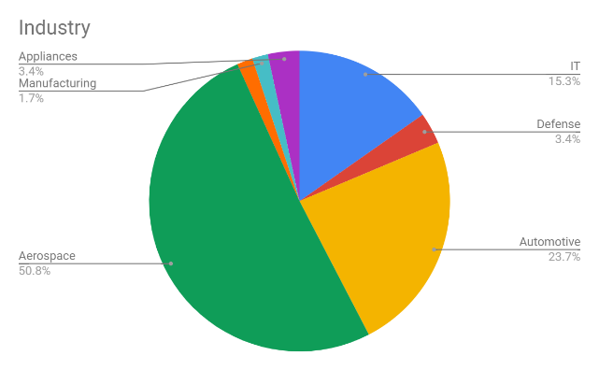
Who are we ?
Participating for
Interesting divide
Experienced SE professionals - busy, cynical, custom/domain specific MBSE
New to SE - enthusiastic, comfortable with models, limited scope

Slide 5
Working Group Activities

Slide 6
Initial few meetings
Past and ongoing MBSE efforts (INCOSE, OMG)
Review of some MBSE webinars
Overview of SysML
...
Challenge - Use MBSE to define “Smart Parking Lot” architecture

Slide 7
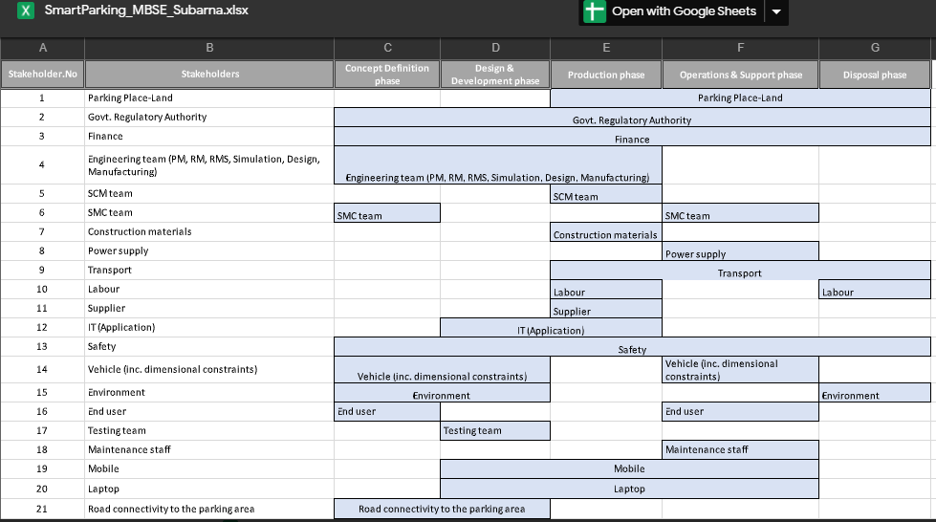
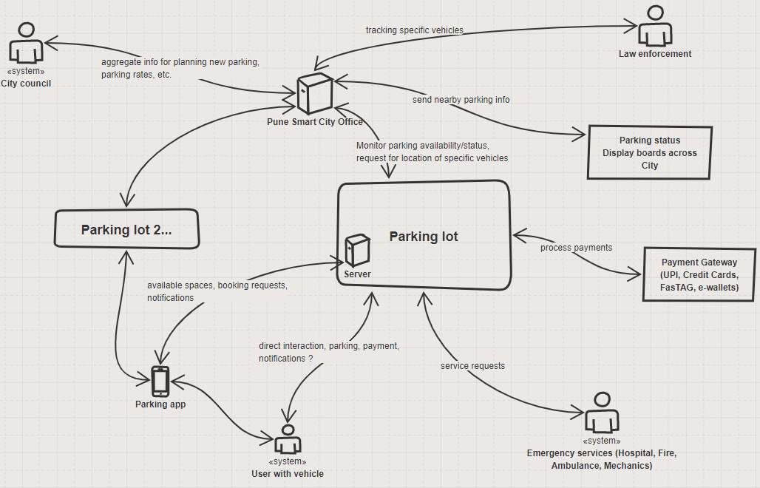
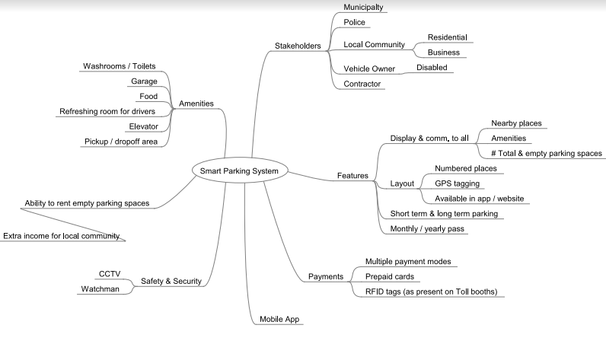
Where to start ?

Slide 8
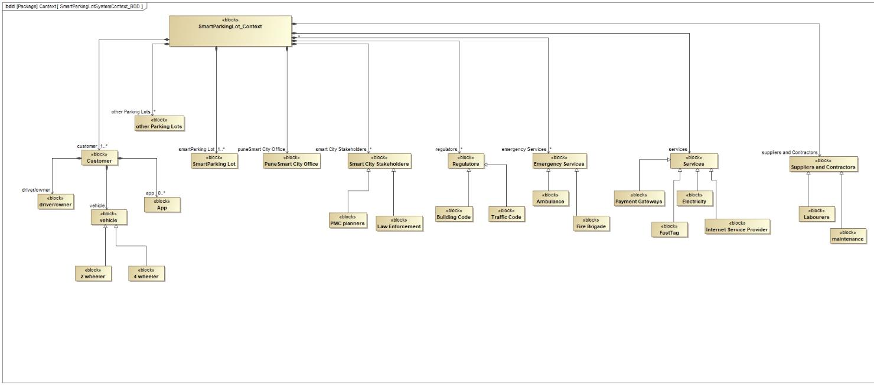
Defining the context

Slide 9
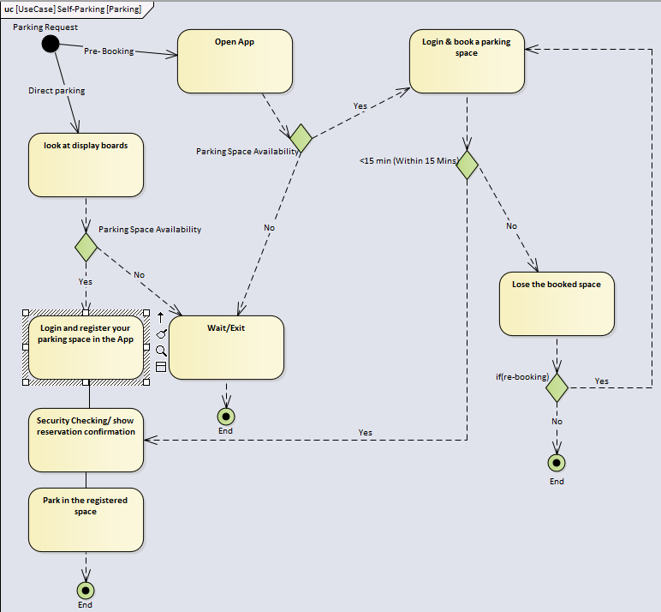
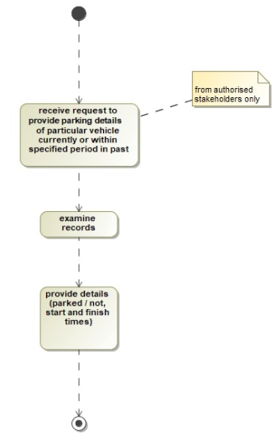
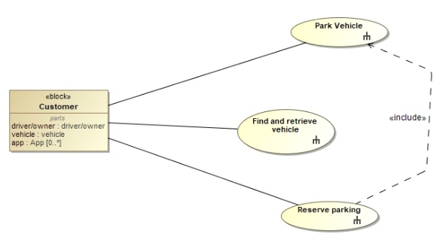
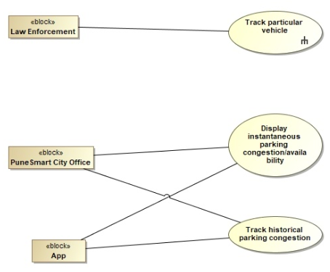
Use cases

Slide 10
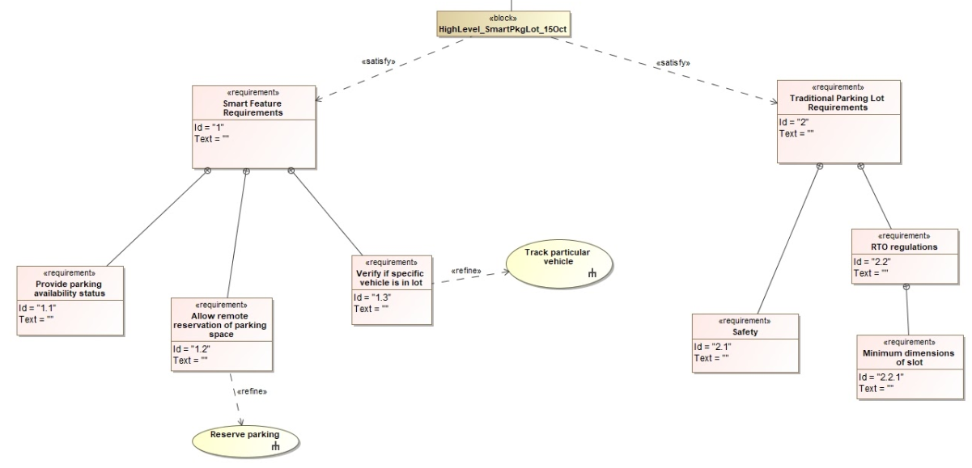
High level requirements

Slide 11
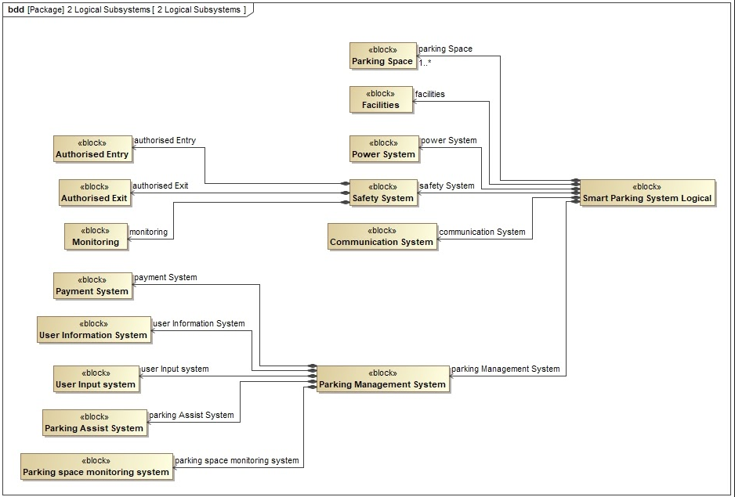
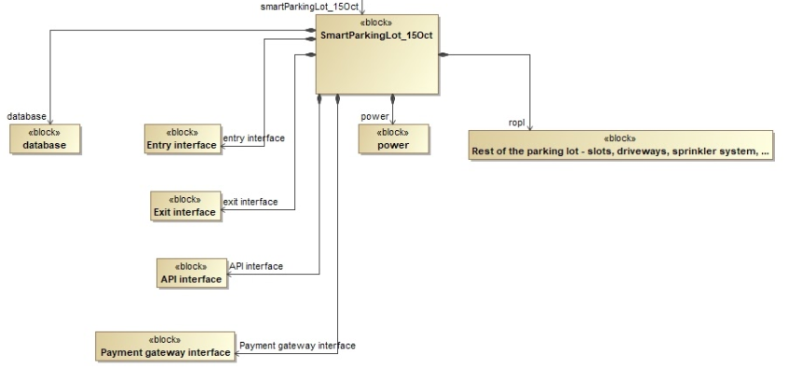
Alternate Logical Architectures

Slide 12
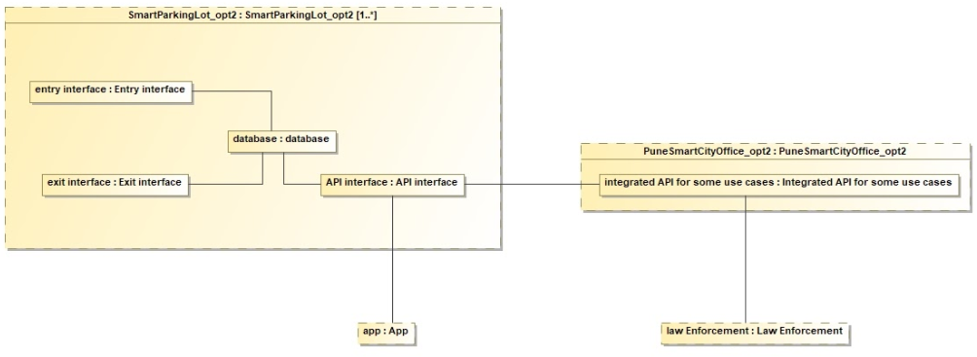
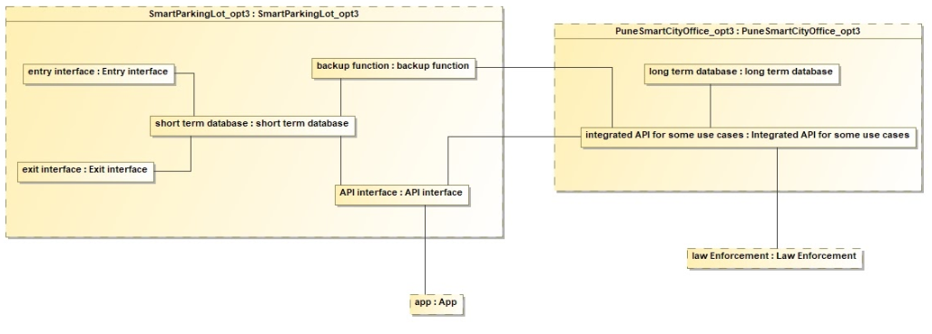
Sub-systems (1 level down) alternatives
Database - Understanding scope

Slide 13
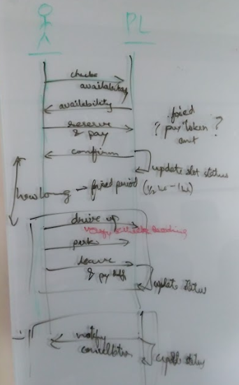
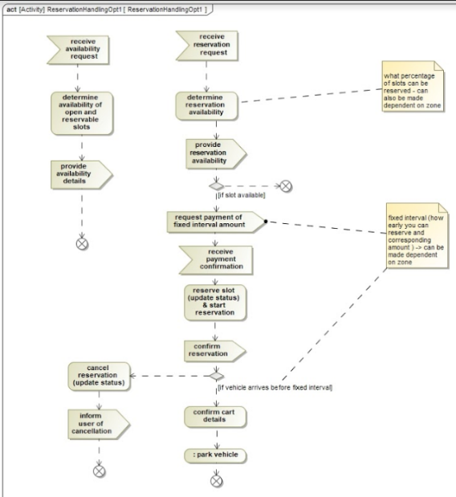
Sub-systems (1 level down) alternatives
Reservation System - Refining behavior and requirements

Slide 14
Sub-systems (1 level down) alternatives
Reservation System - Refining behavior and requirements through Simulation
Link to video of simulation model:
https://drive.google.com/open?id=1ISlEM3-p52IgFhxvsjEthq8yO7YqPn6J
Link to simulation model on Anylogic Cloud:
https://cloud.anylogic.com/model/f648b605-35f0-4371-a8ea-876086d603e5?mode=SETTINGS

Slide 15
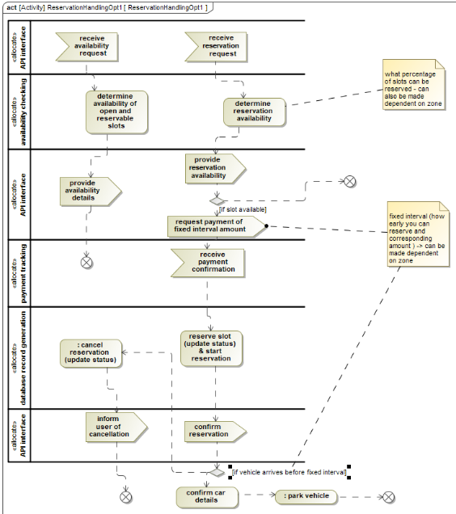
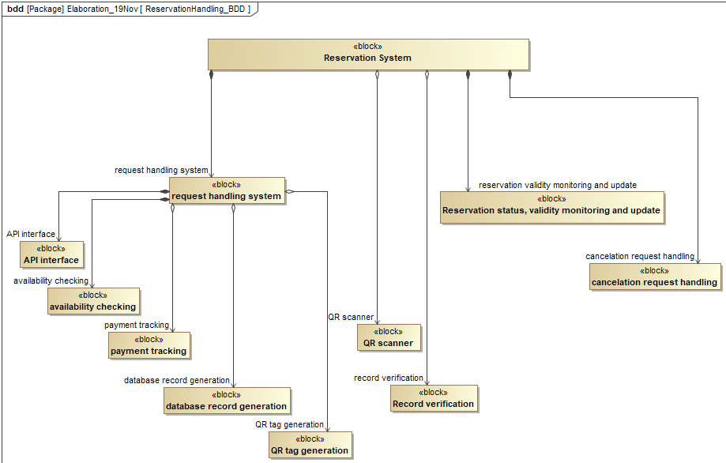
Sub-systems (1 level down) alternatives
Reservation System - Refining behavior and requirements

Slide 16
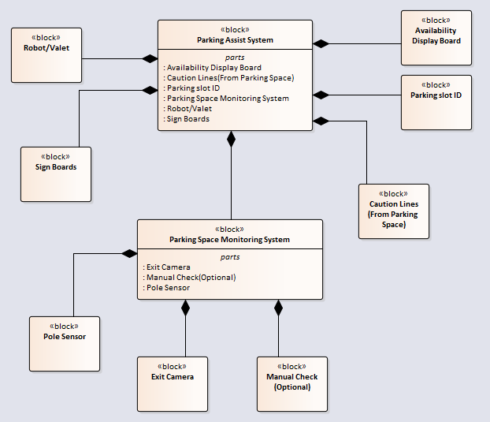
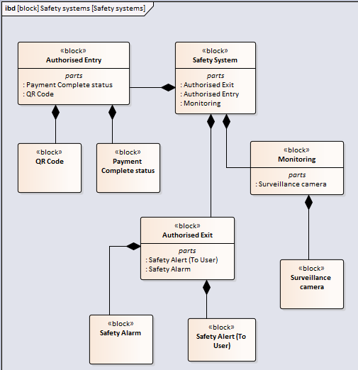
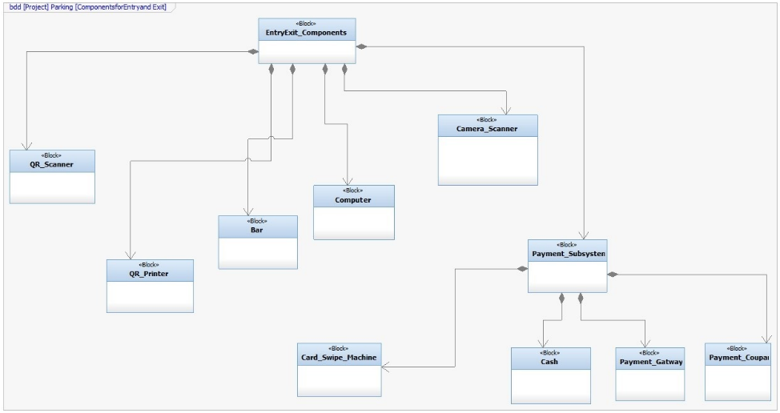
Sub-systems (1 level down) alternatives
Other sub-systems

Slide 17
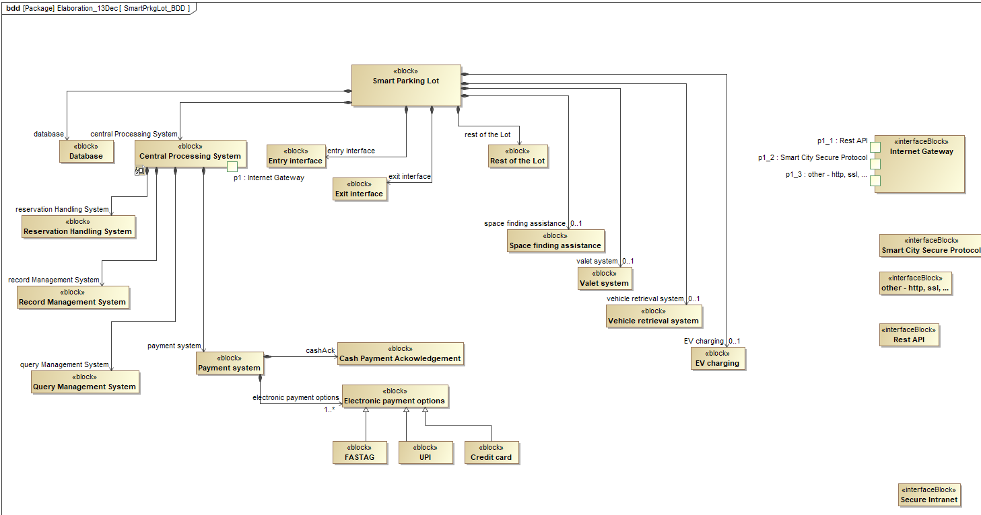
Proposed Reference Architecture - BDD
Combining sub-systems into a consistent system (1 level up)

Slide 18
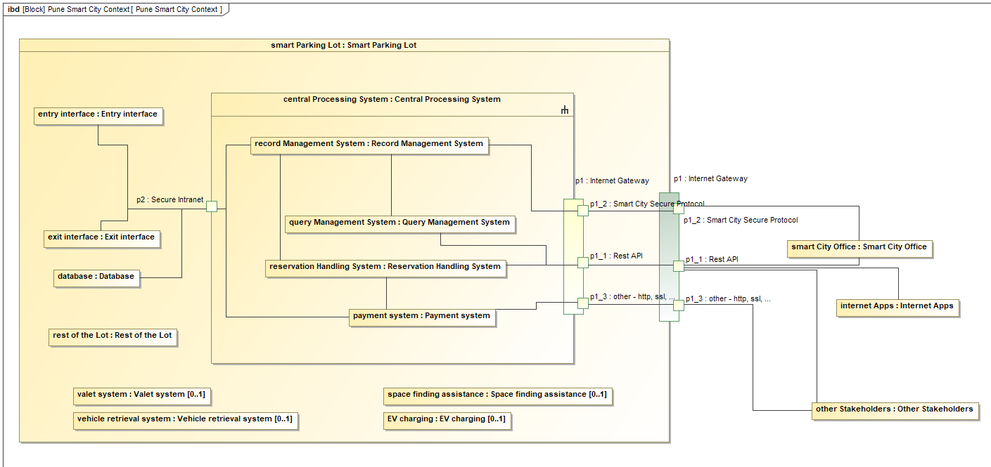
Proposed Reference Architecture - IBD
...

Slide 19
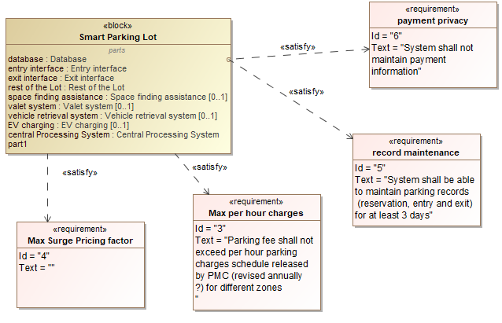
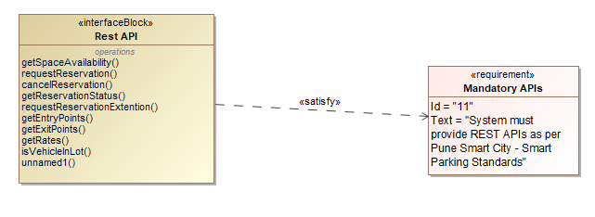
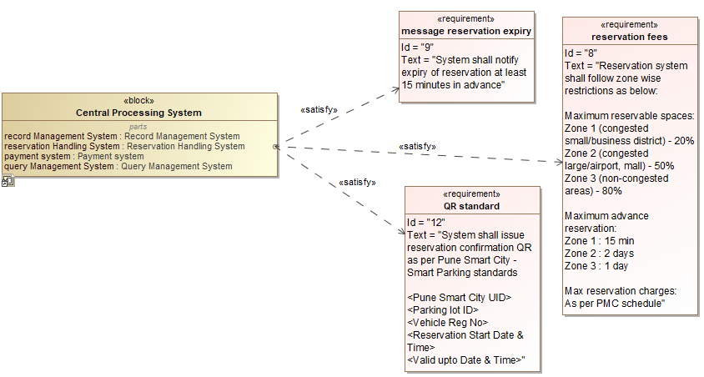
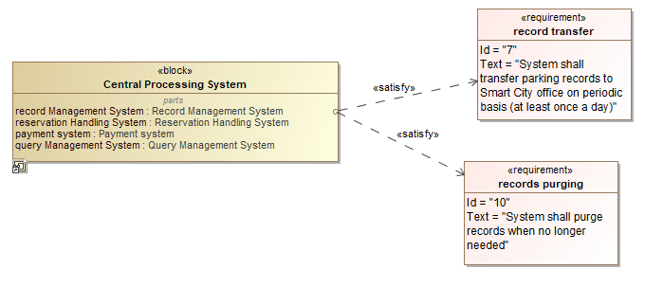
Proposed Reference Architecture - Requirements

Slide 20
#SysML4Fun

Slide 21
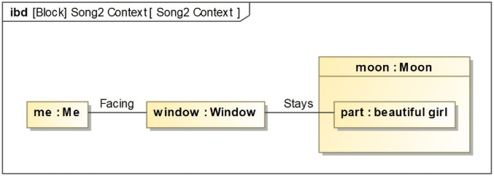
#SysML4Fun - Quiz
The song :
https://youtu.be/S0WPSYFm7iE
Follow us here : https://www.linkedin.com/feed/hashtag/sysml4fun/
Inspiration: Jon Holt, Scarecrow Consultants

Slide 22
Working Group Aspirations

Slide 23
What do we do next ?
“Smart Parking Lot”
Prepare formal case study / reference product for INCOSE/OMG ?
MBSE for INCOSE Grand Challenges
Support SysML v2 evaluation
Trainings/ guidance from MBSE experts
Let us know if you are travelling to India

Slide 24
Nikhil’s learnings

Slide 25
“People” struggle with SysML
Are we good architects ?
Level of detail (what all to model ?)
Linear/Step-by-step thinking v/s Flexible and iterative
How can we tell if we did a good job (architecting OR modeling) ?
Architecting process differs by domain
Veterans find it insufficient
Can’t do MBSE the way SE is taught
Too much to learn
Youngsters have roles with limited scope
Tool variability is confusing & distracting – sharing across tools difficult

Slide 26
Challenges for MBSE community
Create examples showing how to use models
Not “how to model” - but “how model helps to …”
Especially within limited scope / role of young early adopters
Support for work in progress
Alternatives, attributes, selection rationale
Support for collaboration and hand-offs
Back and forth: System<->sub-system, interacting <sub-systems>
Demonstrate how MBSE fits in overall SE methodology
Back and forth between SysML models -and- performance models/actual tests/program management/…
Temporal aspects of structure (and behavior)

Slide 27
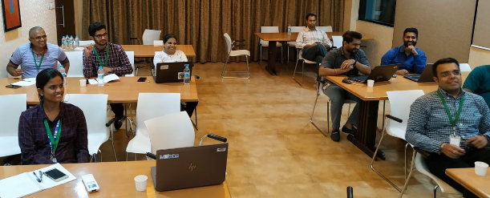
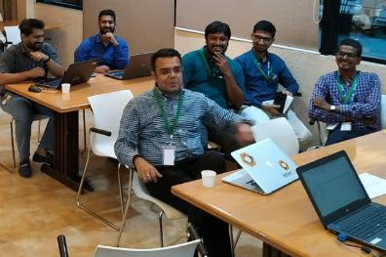
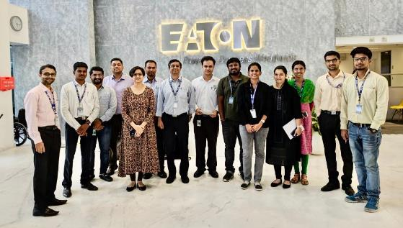
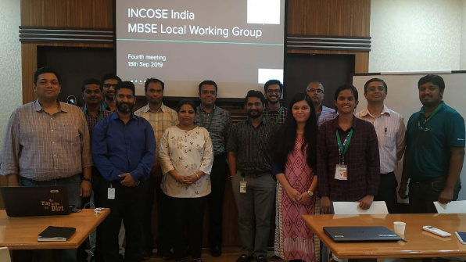
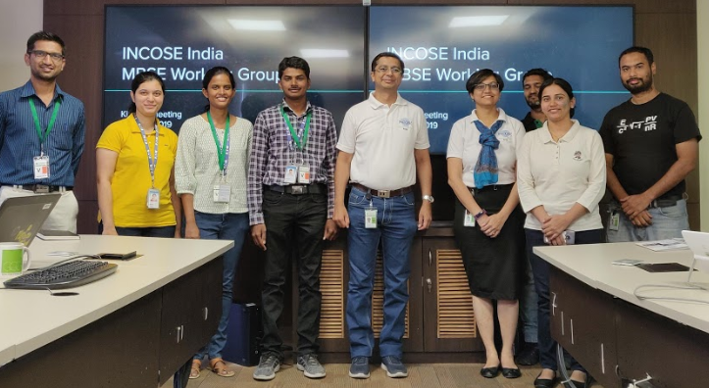
Visit us !
Thanks !

