Slide 1
INCOSE MBSE Initiative
Concept Engineering Working Group
Core Team Members:
Dr Quoc Do (DASI, UniSA)
Prof Peter Campbell (DASI, UniSA)
Paul Logan (Aerospace Concepts)
Dan Spencer (Aerospace Concepts)
Dr Mike Ryan (UNSW)
Jonathan Hallett (Deep Blue Tech)
Dr Dave Harvey (Aerospace Concepts)
Kevin Robinson (DSTO)
Prof Stephen Cook (DASI, UniSA)

Slide 2
Overwiew
Introduction to MBSE 2011 Activities in Australia
Formation of our MBSE Concept Engineering Working Group
Future Plan and Activities
Summary
Notes:
Definition of Concept Engineering - A method for determining what features a product should have, and what metrics can be used to measure the quality or performance of the product, based on analysis of customer needs and preferences. (www.businessdictionary.com/definition/concept-engineering.html)
Concept engineering is the process of translating customer needs to design features and measurable performance parameters. (http://www.visitask.com/concept-engineering-g.asp)

Slide 3
Introduction to MBSE 2011 Activities in Australia
MBSE Panel at the Systems Engineering Test and Evaluation (SETE 2011) conference in Canberra, May 2-4, 2011
Panel Title: Model-based Systems Engineering (MBSE) Panel and Open Forum
Six Panel Members: Kevin Robinson, Paul Logan, Prof Peter Campbell, Jonathan Hallett, Despina Tramoundanis & Dr Quoc Do
Moderator: Dr Mike Ryan
Four focussed questions:
What are the challenges in MBSE?
How does the community promote MBSE and improve its adoption?
Where / how is MBSE currently being applied in Australia?
Is there a need for an Australia forum on MBSE? If so, what implementation would have the greatest effect?
Outcomes:
Attendance: Approximately 60 people
Identified a need for a forum/WG to foster MBSE development in Australia

Slide 4
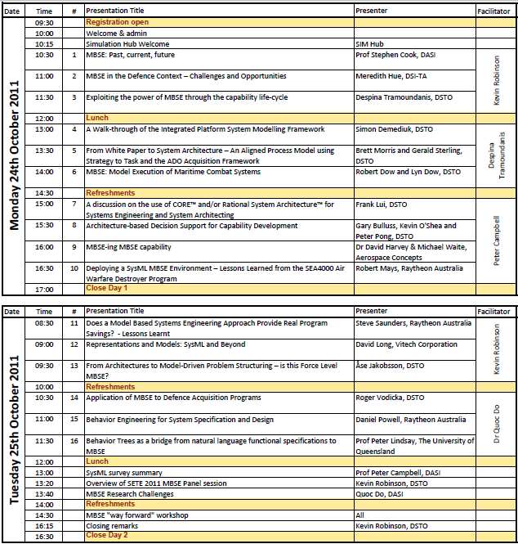
Introduction to MBSE 2011 Activities in Australia
MBSE Symposium, Oct 24-25, 2011 in DSTO, Adel, Australia
Conference Chair: Kevin Robinson
Technical Chair: Dr Quoc Do
2 Day Program with 16 technical presentations and 1 MBSE “Way-Forward” workshop
Attendance: over 90 people
Key outcomes:
Raised a significant level of interest in MBSE
Urged of forming of an Australian MBSE Working Group to foster MBSE development and adoption, and actively contributing to the International effort via the INCOSE MBSE Initiative.

Slide 5
MBSE – Concept Engineering Working Group Formation
A kick-off Meeting, Thursday Jan 12, 3:30-5:00pm
Team Formation and Affiliation:
Name: MBSE Concept Engineering
Plan to be affiliated as an INCOSE MBSE Initiative WG, and as a SESA – SIG (Systems Engineering Society of Australia – Special Interest Group).
The team converges on the following focus areas:
Model-Based Systems Acquisition which focuses on the interface between above-the-line and below-the-line work (ie acquirer and supplier)
Model-based requirement engineering
Model-based design (drive design activities vs record design artefacts)

Slide 6
MBSE – Concept Engineering WG Future Plan and Activities
INCOSE MBSE IW12 Activities:
Workshop Participation
Team meeting at the IW12 with Sandy and others
Team meeting with Sandy in Adelaide, Feb 16, 2012.
MBSE – Concept Engineering WG Regular Meetings:
Feb 21: Meeting in DSTO, Adel
May 2012 – Meeting at SETE 2012
Aug 2012 – Meeting in Canberra
Nov 2012 – Meeting at the MBSE Symposium 2012
Key Activities:
Gain official affiliation with INCOSE MBSE Initiative (in progress)
Gain official affiliation with SESA (in progress)
Forming a Challenge Team on Model-Based Acquisition
MBSE Panel SETE12, May 2012, Queensland, Australia
MBSE Symposium (TBA), in Oct/Nov 2012 DSTO, Adel, Australia
INCOSE MBSE International Workshop 2013

Slide 7
MBSE – Concept Engineering WG Summary
A significant and burgeoning level of interest in MBSE in Australia
Related MBSE activities include: SETE11 Panel and MBSE Symposium in Adel, Oct 24-25, 2011
Recent formation of the MBSE Concept Engineering Working Group to foster MBSE Development in Australia
A plan for the MBSE Concept Engineering WG and 2012 key activities:
Regular quarterly team meetings
Form an MBSE Challenge Team on Model-Based Acquisition
Organise an MBSE panel at the coming SETE12
Organise the next MBSE Symposium in Australia in Oct/Nov 2012
Participate in the coming INCOSE MBSE IW2013

