Slide 1
Model Based Engineering at Raytheon Missile Systems
A Case Study
Stephanie Sharo Chiesi
Louisa Guise
January 29, 2017

Slide 2
Overview of MBE at RMS
Implementation
Development
Domains
How MBE is used and where
What efforts are leading the way for better MBE
How do different domains interact in the MBE ecosystem and throughout project lifecycle
Resources and Training
How is MBE supported and Infused
At the Center, MBE is a Culture Change

Slide 3
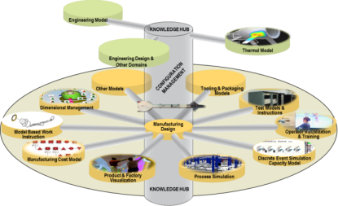
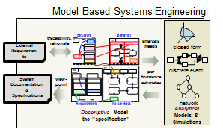
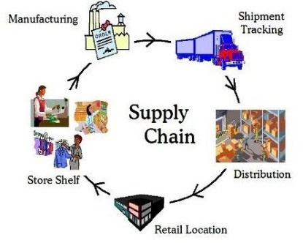
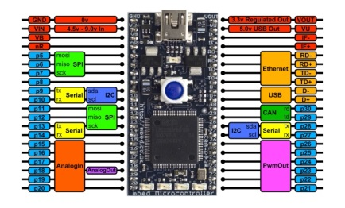
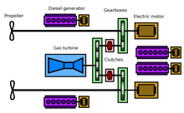
The Complex Model Ecosystem
Model Based Mfg
Model Based Supply Chain
Model Based Systems Engineering
Model Based Test
Model Based Definition
Model Based Software
Model Based Electrical
Notes:
Combined, these individual efforts create a complete digital system model. A fully integrated digital system model enables programs to pull a digital thread to analyze performance and change impacts faster and with more accuracy.

Slide 4
Current MBE at RMS
Development in Domain Centric Tools
Integrating and linking data between domain tools
Evolving the Ecosystem
Embraces best practices
Pilot Programs
Training on SE with Models
Teach individual pillars of methodology, language and tools for better education and adoption
Integrating the process with the associated technologies
Specific identified tools for implementation
Working with the customer to define the future of Digital Engineering
Active engagement with OSD
Notes:
An increasing amount of content in RFPs relates to Digital Engineering

Slide 5
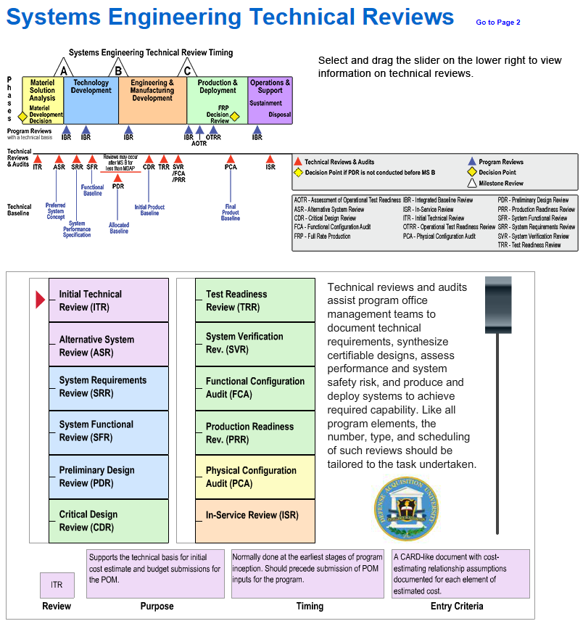
Implementation Effort – MBE Centric Reviews
Why do we hold reviews?
Formal part of customer acceptance of product
Preview material before presenting or delivering to the customer
Ensure completeness
Peer Reviews
Find errors, omissions, risks, opportunities
Acquisition Community Connection sponsored by the DAU
Inform, Involve, Communicate
Notes:
Example from some current program implementations – work culture change through reviews and review effectivity.

Slide 6
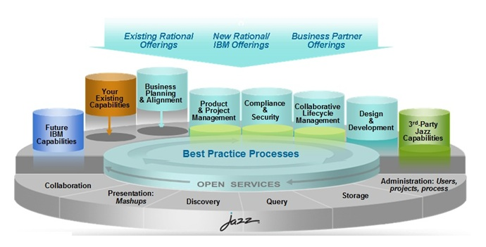
Utilizing Reviews as MBE Enabler
Support MBE core principles
Supports Agile practices
Provides history of design decisions
Provides basis for future development and investigation
Utilizes standards and engages the MBE ecosystem
https://www.ibm.com/developerworks/mydeveloperworks/blogs/govbydesign/resource/
BLOGS_UPLOADED_IMAGES/JazzArchitecture.jpg
Capture review data in engineering tools for insight to decisions
Notes:
Example from some current program implementations – work culture change through reviews and review effectivity.

Slide 7
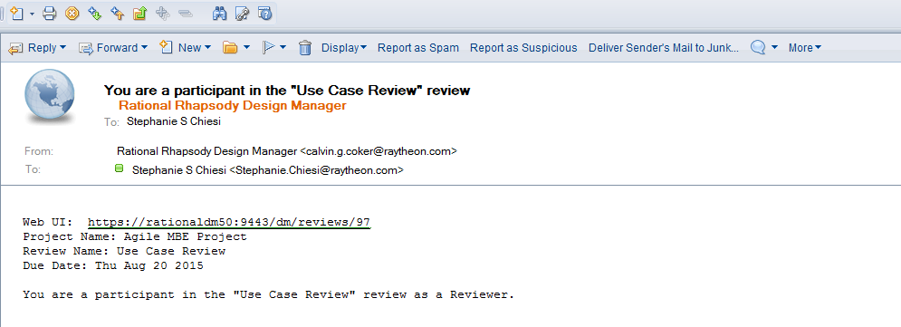
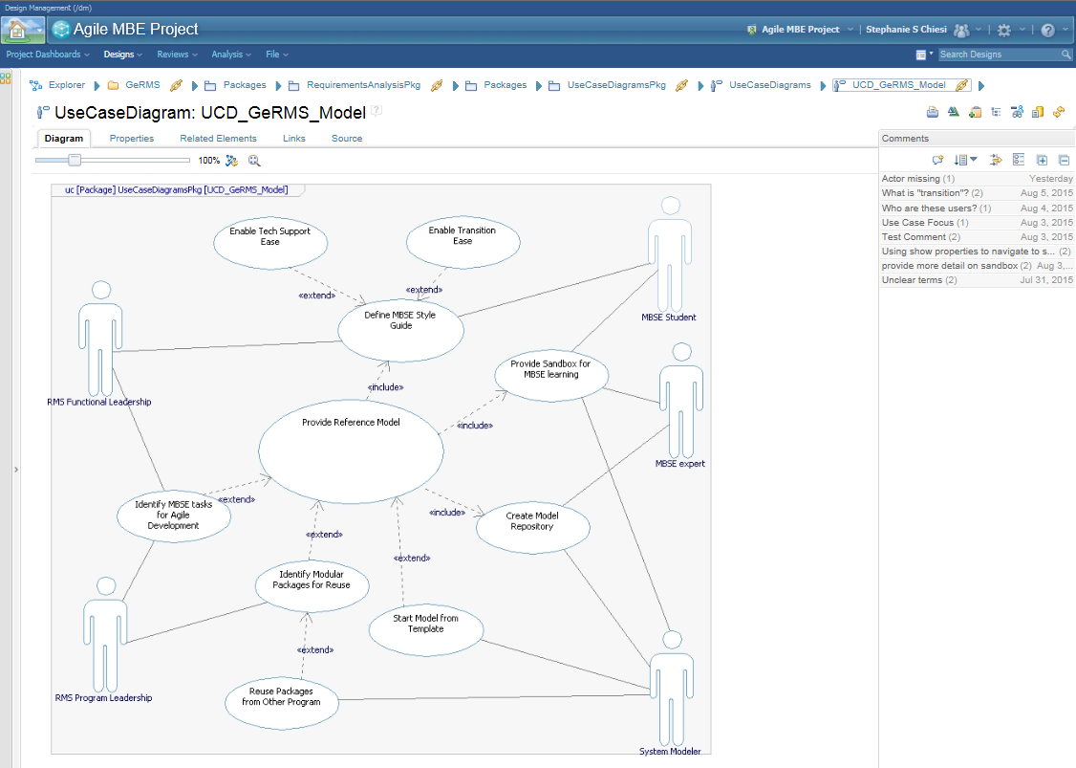
Feedback on approach
Positive feedback from teams
One sheet guidance for use helps non-domain users learn
Changes the way other domains approach the review
Incorporate multi-disciplinary efforts in one review through OSLC linking
Helps exercise the ecosystem for future development
Introduce through hands-on practice and program needs
Notes:
Example from some current program implementations – work culture change through reviews and review effectivity.

Slide 8
Future of MBE at RMS
Notification of changes
Increased integration of digital models across program lifecycle
Improved digital system model analysis
Subscribe to changes
Involve supply chain
Metrics determination and reporting
Changes across domain development
Upward and downward drivers
Operations/Manufacturing
Collaboration with customers
Cross-discipline/domain trade studies
Completing the Digital Thread

