Slide 1
Model Curation
Donna H. Rhodes
Massachusetts Institute Of Technology
rhodes@mit.edu
July 9, 2018

Slide 2
Informing Digital Engineering Transformation Human-Model Interaction Research
Application Cases and Experiments
Model-Centric Decision Making Study
Analogy Cases and Secondary Source Data
Technical Exchange
Workshops
Research Indicates New Leadership Capabilities Needed

Slide 3
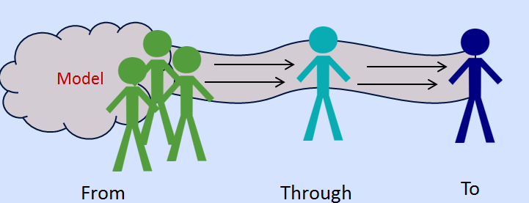
Study finding Model Trust and Integrity Based on technical and social factors
Technical Factors
Social factors
Model complexity
Data availability
Data quality
Fidelity and uncertainty
Adequacy of methods
Transparency and documentation
Verified algorithms
….
Model originator and subsequent experts
Revealed assumptions
Changing preferences
Willingness to share models
Ability to socialize models
Generational differences
Fear of unknown
Lack of desire to understand
Organizational differences
Negative past experiences
….
… the trust for ultimate decision-maker is “implicitly on the models, but explicitly on the people”

Slide 4
Decisions Involved in Using/Managing Model-Centric Environments
Architect an airport collaborative decision making system (CDM)
“share real-time flight information and delegate authority to sequence departures, in order to maximize capacity use and reduce congestion”
Complex situation – many model types, interconnections, data sets, visualization techniques …and more
Reymondet, L., Rhodes, D.H. and Ross, A.M., Considerations for Model Curation in Model-Centric Systems Engineering, IEEE SysCon 2016

Slide 5
Driving Factors for Model Leadership Role
Models becoming increasingly valuable, leading to equal/greater value than physical asset
Need for composability of models for specific purposes beyond original use, requires knowledge depth and breadth
Modeling competency across individuals and programs, but not strategically developed/managed at enterprise level
Models exist at all levels of enterprise (individual, program, business unit) but seldom managed as enterprise collection
Need to distinguish which models are elevated to the enterprise collection (deemed of value and quality to be used across the enterprise, and worthy of distribution outside the enterprise (by exchange, loan, sale…)

Slide 6
museum curator
accessions
valuation of assets
strategic loan/acquire
oversight of collection
set collection policy/practices
strategic planning for future
leadership of special exhibits

Slide 7
Digital Curation (National Research Council) The phrase “active management and enhancement” was chosen to distinguish curation from simply collecting and storing data and information
…allow users to understand and exploit digital information assets and to ensure their integrity over time
…ensure digital information remains discoverable, accessible, and useable for as long as potential users have a need or a right to use it.
What distinguishes digital curation from these other fields is its emphasis on enhancing the value of information assets for current and future use and its attention to the repurposing and reuse of information, both within and beyond the context in which it was first created or collected.
Preparing the Workforce for Digital Curation, National Academies Press, 2015

Slide 8
model curator
enterprise model accessions
valuation of model and digital artifacts
oversight of model collection activities
strategies for model-centric future
leadership for model demonstrators
strategic loan/acq of models
set model collection policy/practices

Slide 9
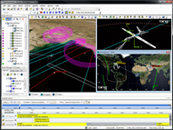
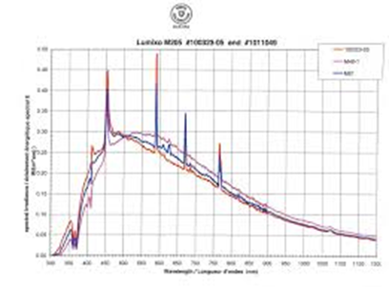
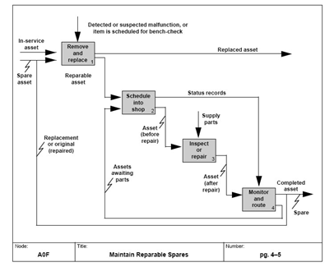
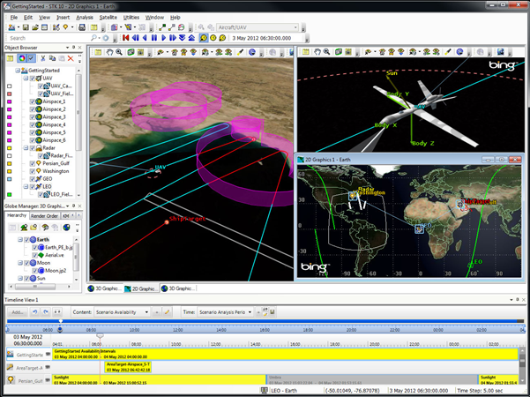
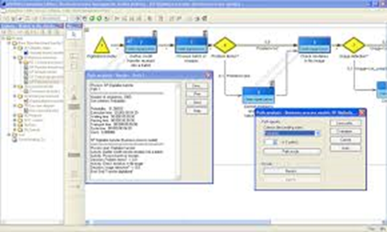
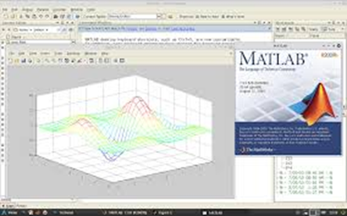
model accessioning
Accessioning is the formal process of officially accepting models (sets of models) into enterprise level model collection
establish legal ownership, IP, verifies integrity, validates pedigree, etc.
de-accessioning is equally important formal process
enterprise collection
models

Slide 10
Example Responsibility Model Accession
Accessioning is the process of officially accepting models (and sets of models) into the enterprise level model collection.
An accession is the acquisition of a single model or set of models, from one source, under one type of transaction (elevated to global, exchange, purpose…), as of a single date
Accessioning establishes legal ownership, IP, validity of pedigree, etc.
Developed or acquired? Or existing local asset elevated to global asset? Adapted from open source? Purchase or exchange?
Condition at accession recorded, establishing initial pedigree
Model and pedigree info recorded with unique identifier
Placed under CM
De-accessioning is also a key responsibility

Slide 11
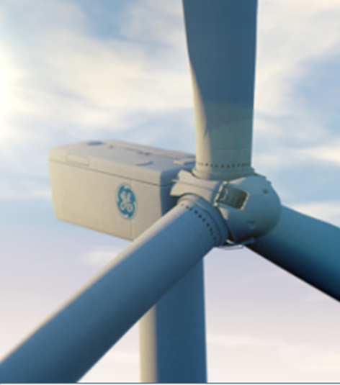
valuation of models and digital artifacts
Are physical products and models of the product two separate things?

Slide 12
managing model acquisition activities
ACQUISITION
The act of acquiring a model through a formal arrangement with the model owner (e.g., through purchase, trade, or other business transaction).
LOANS
The act of temporarily loaning a model through an agreement whereby the model owner agrees to share the model with the model acquirer for a specified time and specified terms (e.g., terms of use, remuneration, etc.).

Slide 13
policy and practices
Enterprise Level (chief model curator)
Program Level
Executive owner for the modeling and simulation standards, data pedigree, and model pedigree
Establishes culture and enablers for model-centric environment
Sets policy and guiding principles
DoD Digital Engineering Working Group SE Digital Engineering Fundamentals (2016)
The responsibility of planning and coordinating programs’ use of models, simulations, tools, data, data rights, and the engineering environment belongs to the program manager; the performance of the actual may be delegated to the program systems engineer and other program staff as appropriate

Slide 14
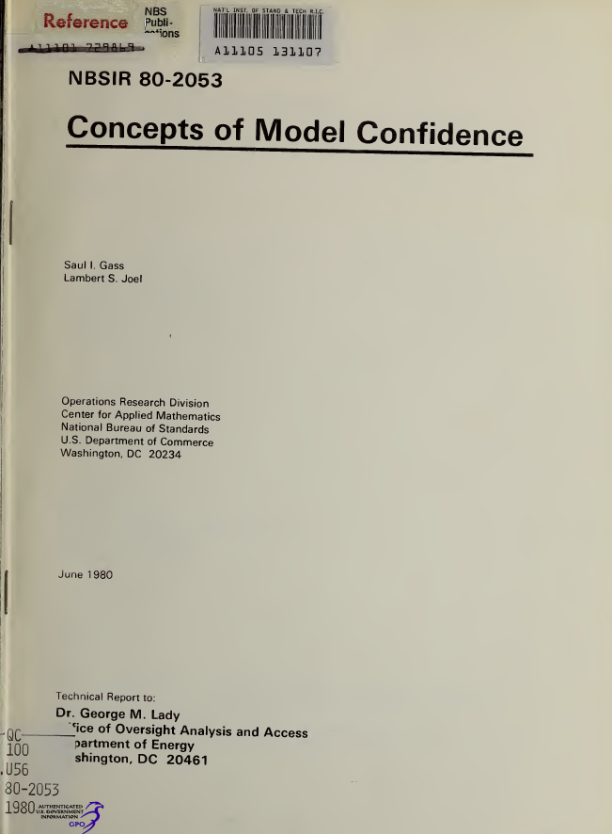
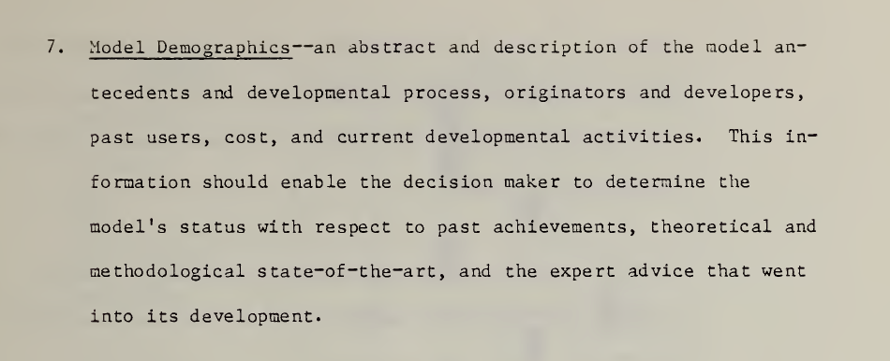
standard model pedigree
Model Pedigree: Model-associated information that describes model origin, originators and developers, development process, assumptions, expert knowledge, model enhancements, investment costs, versions, change history, etc.
Adjunct to the technical model details and metadata
Model pedigree not a new idea (1979, Gass) but little attention in our field

Slide 15
guiding principles
Rhodes, D.H., Using Human-Model Interaction Heuristics to Enable Model-Centric Enterprise Transformation, IEEE SysCon 2018

Slide 16
leadership for model demonstrators
Museum curator has deep knowledge of collection, with responsibility for putting together purposeful special exhibits
Similar role – “chief model curator” has deep knowledge of model collection and strategies for model composability
Has strategic responsibility for selecting and composing models for a special purpose, for example, demonstration of new system capability in support of a competitive bid or market opportunity
geralt

Slide 17
where are things headed?

Slide 18
hypothetical Leadership Evolves with Shifting Digital Paradigm
Paradigm Shift | Leadership | Enterprise Characteristics …
Model Use Throughout Program | “Local” model management | Models are primary artifacts replacing documentation Limited reuse of models Organization embraces importance of models
Model Reuse Across Programs | Distributed model leadership | Models-based engineering as standard practice Models are reused across programs in business unit Model-centric enterprise culture
“Digital Twin” Throughout Lifecycle | Designated executive leader | System “digital twin” maintained through lifecycle Enterprise practices for modularity, composability, etc. Model-centric culture embedded across enterprise
IP Inversion | “Model curation” top-tier executive | Models (Digital Twins) are key deliverables Model IP more valuable than product (model sold, exchanged, loaned) Innovations emerge from composability of models

Slide 19
Enterprise Level Curation Role Potential Organizational Forms
Organizational Form | Implementation
Centralized – Top Tier | CMCO is top executive reporting directly to CEO
Centralized – Dotted Line | CMCO has enterprise level authority, “dotted line” reporting to CEO
Franchised | Enterprise segments have CMCOs, conforming to enterprise defined policy and role.
Collaborative | Virtual CMCO role through collaborative committee
Dual Hat | CMCO is one of two roles played by an executive
Delegated | CMCO responsibilities are delegated to a committee, to one or more individuals
Outsourced | CMCO role is performed by an external hire
CMCO – “Chief Model Curation Officer”

Slide 20
Model Curation - Interim Research Findings
Semi-structured interviews indicate enterprise executives recognize need for enterprise-level leadership for strategically managing model assets and environments
Curation knowledge/practices from other areas (museum, digital, ….) inform model curation in engineering context
Seven alternative organizational forms for model curation leadership identified, along with possible conditions under which these the form would be most appropriate
CURRENT RESEARCH
Framework for Assessing Model-Centric Enterprise Capabilities -- evidence-based approach respective to transformation state from traditional to fully digital MBE

Slide 21
Lexicon

Slide 22
Chief Model Curation Officer | A designated professional, authoritative role – at the executive level of the enterprise - entrusted with the ownership, tracking and use of model-based assets.
Model Accessioning | The formal process of accepting and recording a model as a collection object in the enterprise level model portfolio. Accessioning addresses the legal, IP and ethical issues in model acquisition and development.
Model Acquisition | The act of acquiring a model through an arrangement with the model owner (e.g., through purchase, trade, or other business transaction).
Model Cataloging | The formal process of making a model available for use through recording it in a catalog or directory, and tracking it throughout the model lifecycle.
Model Collection | The collection of model-based assets that is possessed by an enterprise, including those developed by the enterprise, acquired by the enterprise, and temporarily resident in the collection (e.g., leased, on loan).
Model Collection Object | A model or model-related object that is a unique asset in the enterprise’s collection. An object is assigned a unique identifier.

Slide 23
Model Curator | A designated professional role entrusted with the ownership, tracking and use of model collection objects, and possessing designated authorities for managing and controlling models.
Model Composition | The process of composing models and model-related information that provides collective value beyond the individual models.
Model Composability | The characteristic of an interrelated set of models that enables them to be combined in accordance with given modeling formalisms.
Model De-accessioning | The formal process of removing a model as a collection object from the enterprise level model portfolio.
Model Demonstrator | A composed set of models with interactive interfaces for the purpose of demonstrating context-specific capability. Demonstrators enable the modeled system to be experienced by an individual through conveying cogent information and where possible, the use of interactive interfaces.

Slide 24
Model Loan | The act of temporarily acquiring a model through an agreement whereby the model owner agrees to share the model with the model acquirer for a specified time and specified terms (e.g., terms of use, remuneration, etc.).
Model Metadata | Descriptive metadata is contextual data about the model object(s). Metadata documents characteristics and used for indexing, discovering, identification. Provides user discovery of, access to, and management of an object.
Model Pedigree | Model-associated information that describes model origin, development process, originators and developers, assumptions, expert knowledge, model enhancements, investment costs, versions, change history, etc.

Slide 25
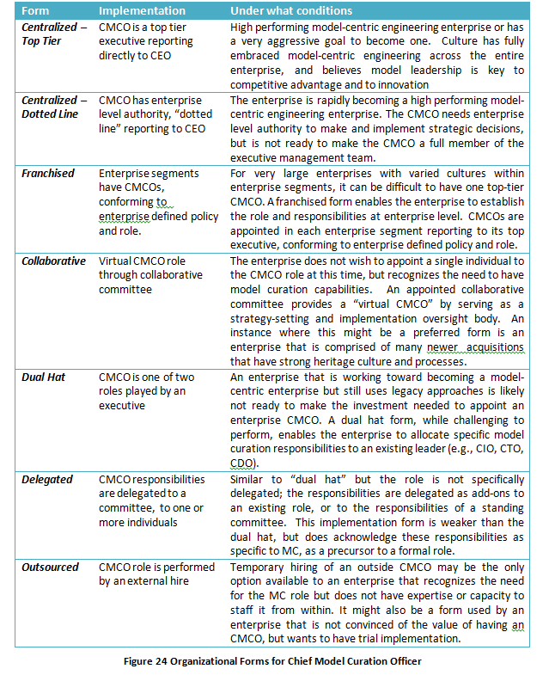

Slide 26
Questions?
Dr. Donna H. Rhodes
Massachusetts Institute of Technology
rhodes@mit.edu
seari.mit.edu
This material is based upon work supported, in whole or in part, by the U.S. Department of Defense through the Systems Engineering Research Center (SERC) under Contract HQ0034-13-D-0004. SERC is a federally funded University Affiliated Research Center managed by Stevens Institute of Technology. Any opinions, findings and conclusions or recommendations expressed in this material are those of the authors and do not necessarily reflect the views of the United States Department of Defense.

