Slide 1
NASA Model-Based Systems Engineering Pathfinder 2016 Summary and Path Forward
Karen J. Weiland, Ph.D.
NASA Glenn Research Center
Jon Holladay, NASA Systems Engineering Technical Fellow
NASA Engineering and Safety Center

Slide 2
Contents
Motivation for an MBSE Pathfinder
Approach and Mission Focus Areas for 2016
Results from 2016
Overview of 2017 work
Conclusion

Slide 3
Systems Engineering Technical Discipline Team
Organization within the NASA Engineering and Safety Center (NESC), a division of the Office of the Chief Engineer
NESC’s mission is to perform value-added independent testing, analysis, and assessments of NASA's high-risk projects to ensure safety and mission success
NESC engages proactively to help NASA avoid future problems
SE TDT is led by the NASA Systems Engineering Technical Fellow
Provides systems engineering expertise to the agency
Systems analysis
Data mining and trending
Statistics
Technical leadership
Provides senior NASA management with a perspective on the current and projected health of Agency systems engineering
Develops and implements plans for both tactical and strategic Agency systems engineering investments

Slide 4
MBSE Pathfinder Motivation
Numerous MBSE efforts
Several Center workshops
30+ SysML training classes at multiple Centers
NASA Integrated Model-Centric Architecture initiative
Push to transition to a Cloud Environment
Pilot a floating license environment for engineering software
Evaluate a common domain for model archive and sharing
… effectively utilize 21st Century technology, tools and methods across NASA’s diverse portfolio of programs, projects, and technological innovations

Slide 5
Approach
SE TDT established an MBSE Pathfinder
Better align MBSE across Centers
Develop a user community
Capture issues and opportunities for evaluating next steps
SE TDT committed implementation resources
Framework and management of the activity
MBSE training for the participants
Access to a consistent set of MBSE tools
Four Teams
Diverse: technical disciplines, experience, Centers, and NASA missions
Small: five to eight people on each team
Agile: participants had multiple, evolving, and new roles

Slide 6
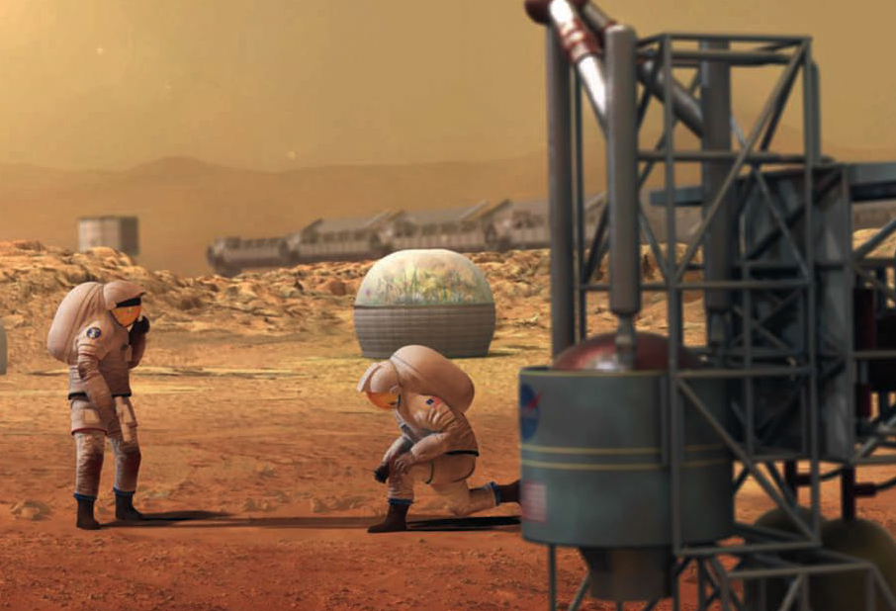
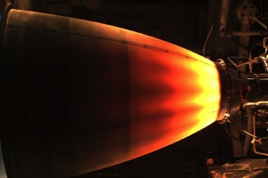
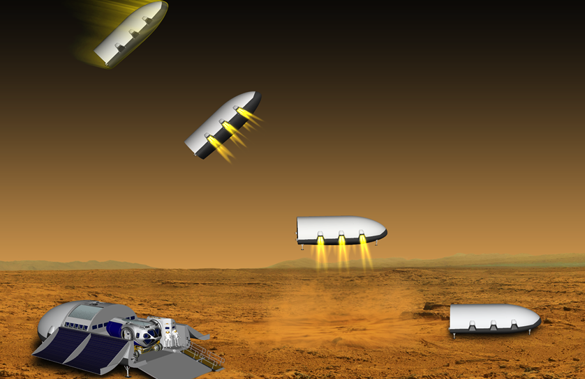
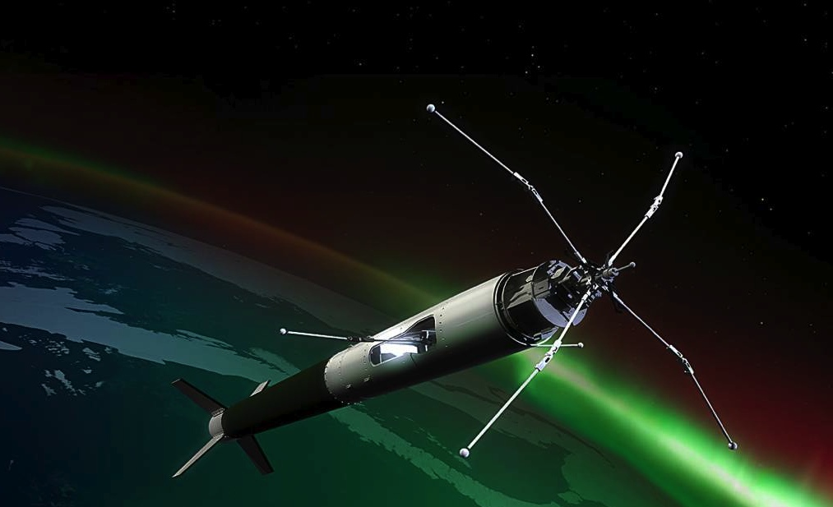
NASA MBSE Pathfinder Informing next steps in Systems Engineering…
Design Reference Mission Architecture - Mars In-Situ Resource Utilization
Advanced Manufacturing -Liquid Oxygen / Methane Engine
Exploration Class Element - Lander
Sounding Rocket Mission Flow Shadow

Slide 7
Objectives
Design Reference Mission Architecture – Mars In-Situ Resource Utilization (ISRU)
Top level and mission-to-mission architecture, re-use of products
Advanced Manufacturing – Liquid Oxygen / Methane Engine
Evaluate MBSE in advanced (additive) manufacturing environment
Exploration Class Element – Lander
Integration of engineering analysis between mission and sub-systems
Sounding Rocket Mission Flow Shadow
Evaluate MBSE in real-world repetitive mission flow environment
Leverage existing data and products for start and comparison
Situational learning, creativity, and innovation in modeling
Maximize exposure to collaborative, virtual system modeling

Slide 8
MBSE Pathfinder 2016 Results
Technical
All teams accomplished a significant amount of system modeling work
Participants used many different approaches, tools, and processes
Participants identified lessons learned along the way and at the end
Benefits to NASA
Trained and experienced cohort – smart buyers
Go-to resource for Centers, Agency, national, and international groups
Increase or revival of Center MBSE working and learning groups
Factors for Success
Management support from all levels
Quick, real-world experiences
Active involvement of experienced and expert personnel

Slide 9
Recommended Next Steps
Demonstrate the value of MBSE
Focus on real NASA missions to show applicability
Production of re-usable SE products
Community of Practice, online collaboration space and libraries
Agency resource for the Centers
Handbooks, training, and seminars for getting started
Architect the NASA ecosystem for MBSE
Establish how systems engineers will do their jobs
Software tools used; what are needed; identify solutions to future needs
Develop and exercise Agency federated software deployment
Cloud based infrastructure for software and models
Shared software licensing approach across Centers

Slide 10
MBSE Pathfinder 2017 Overview
Implement lessons learned from 2016
New or modified mission focus areas
New cross-cutting themes team
Grow the NASA Cloud infrastructure and shared licensing approach
Expected outcomes
Development of SE products across the life-cycle
Integration with various engineering design and analysis tools
Develop planning options for Agency-wide engagement
Use the MBSE Pathfinder as a pilot for options under consideration

Slide 11
MBSE Pathfinder 2017 Cross-Cutting Themes Team
Promote cross-team interactions and product integration
Identify areas of model re-use
Address common topic areas:
Model management
Configuration control
System of interest description
Discipline engineering analysis integration
Risk
Safety & Mission Assurance
Library of common practices
Collect, develop, and assess practices to start a library
Common patterns and terminology for users
Handbook for new users

Slide 12
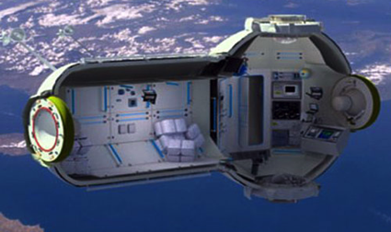
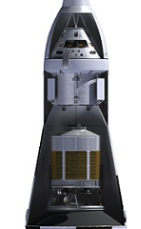
MBSE Pathfinder 2017 Mission Focus Areas
ISRU, Trades for Mars Mission
ISRU portion of a Mars mission campaign
Trade various assets for production on Mars surface
Model re-use, sensitivity analysis, and evaluation
In-Space Habitat Element, Requirements and Design
Habitat design analysis cycle and common architectures
Interactions among the System Model and other engineering disciplines
Agency patterns for future efforts
Engine, Requirements Compliance and Test Configurations
Requirements analysis and verification using engine qualification test data
Validation of an engine power balance model using test data
Track engine and test configurations, conditions, and constraints
Launch Vehicle Payload Adapter, Structure Design and Build
System, interface, and loads analysis requirements
Automate customer requirements to concept, to as-designed and as-built configuration
Configuration management, manufacturing and test of composite structures
Sounding Rocket, Mission Flow Shadowing
Evaluate MBSE improvement over multiple flight iterations
Discipline analysis added to existing MBSE mission models
DoD is partner on programmatic modeling effort

Slide 13
Virtual MBSE Community of Practice
Online collaborative portal
Open discussion among MBSE practitioners of all experience levels
Learning space for SysML and MBSE novices
Place for collaborators to work on content for the knowledge repository
Knowledge repository
Lessons learned
Common models
Design patterns and standards
Interface specifications (within models and among modeling tools)
Model libraries
Scripts

Slide 14
Conclusion
MBSE Pathfinder achieved the 2016 objectives
Teams modeled systems-of-interest selected from NASA missions
Virtual environment represented the modern workplace
Provided significant number of lessons learned for next steps
Established a strong, collaborative community
Plans for 2017 continue to mature the implementation
Stronger NASA program and stakeholder partnering
Continued refinement of modelling integration approach
Within the SE domain
Across other engineering disciplines
Develop and assess a federated Agency MBSE deployment
Moving NASA Systems Engineering Forward…

