Slide 1
Integrating MBSE into a Multi-Disciplinary Engineering Environment A Systems Engineering Perspective
Ron Williamson, PhD
Systems Engineer, Raytheon
20 June 2011

Slide 2
Panel Proposal Context
Model-based systems engineering (MBSE) formalizes the practice of systems engineering through the use of models.
This panel is intended to address considerations for incorporating MBSE into a broader multi-disciplinary engineering environment.
Engineering disciplines use multiple languages and tools whose results are not always easily integrated.
The lack of integration is a source of design discrepancies and errors.
The potential for MBSE …
Provide a means to integrate multi-disciplinary engineering including systems, hardware, software, analysis, and test throughout the development life cycle.

Slide 3
One Systems Engineering Perspective
Systems level thinking and analysis
Establishes the context for the other disciplines
Depends on understanding the constraints/principles employed by these other disciplines.
It ‘s a two way street, involving different analysis viewpoints
“top down” “bottom up” “cross-cutting”
A key aspect of defining systems context includes aspects that can be translated into guidance for the other disciplines
Functional characteristics (structure, decomposition, aggregation)
Interfaces (Complexity, Openness, Standards)
Non Functional Characteristics ("ilities“ constraints)
Behavioral Characteristics (parametric representations)
The underlying disciplines' principles also need to be abstracted/transformed into systems level concepts
Allocation to each disciplines core concepts (form, function, physical constraints)

Slide 4
INCOSE MBSE Roadmap & Vision
MBSE Capability
Reduced cycle times
System of systems
interoperability
Design optimization across broad trade space
Cross domain effects based analysis
Extending Maturity and Capability
Institutionalized
MBSE across
Academia/Industry
Distributed & secure model repositories
crossing multiple domains
Defined MBSE theory, ontology, and formalisms
Well Defined MBSE
Refer to activities in
the following areas:
Maturity
Architecture model integrated
with Simulation, Analysis, and Visualization
Planning & Support
Research
Standards Development
Processes, Practices, & Methods
Tools & Technology Enhancements
Outreach, Training & Education
Matured MBSE methods and metrics,
Integrated System/HW/SW models
Ad Hoc MBSE
Document Centric
Emerging MBSE standards
2010
2010
2020
2025

Slide 5
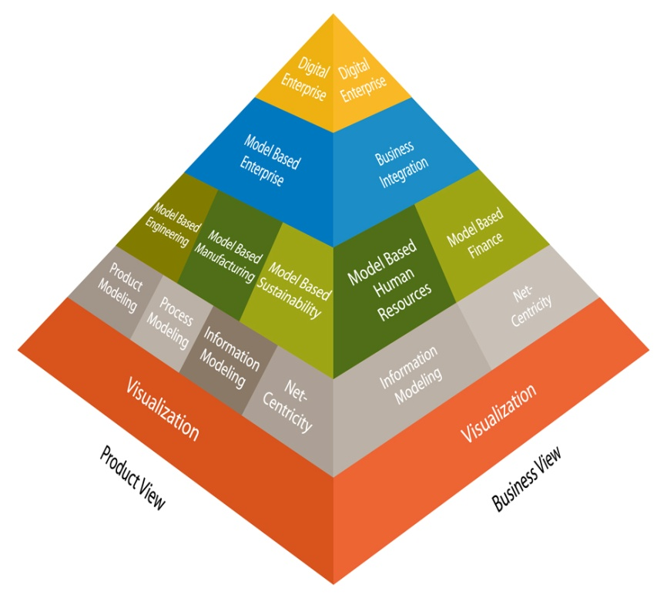
What should systems engineering expect from other disciplines to enable MBSE?
Compatible model vocabularies and semantics
When we use specific terms, their various aspects are clear and can be transformed into each disciplines unique standardized perspectives
Examples include
Aspects of “Interface”
Systems…..logical representation of structure and constraints
Software….logical representation with data types, protocols, etc.
Electro/Mechanical…physical representation e.g. Size, Weight, Power
Aspects of “Component”
Systems…..Logical specification
Software….Logical and Physical deployment characteristics
Electro/Mechanical…Physical characteristics
Aspects of “Threads”
Systems Integration aggregations…”integration threads”
Software behavior … “multi threading”

Slide 6
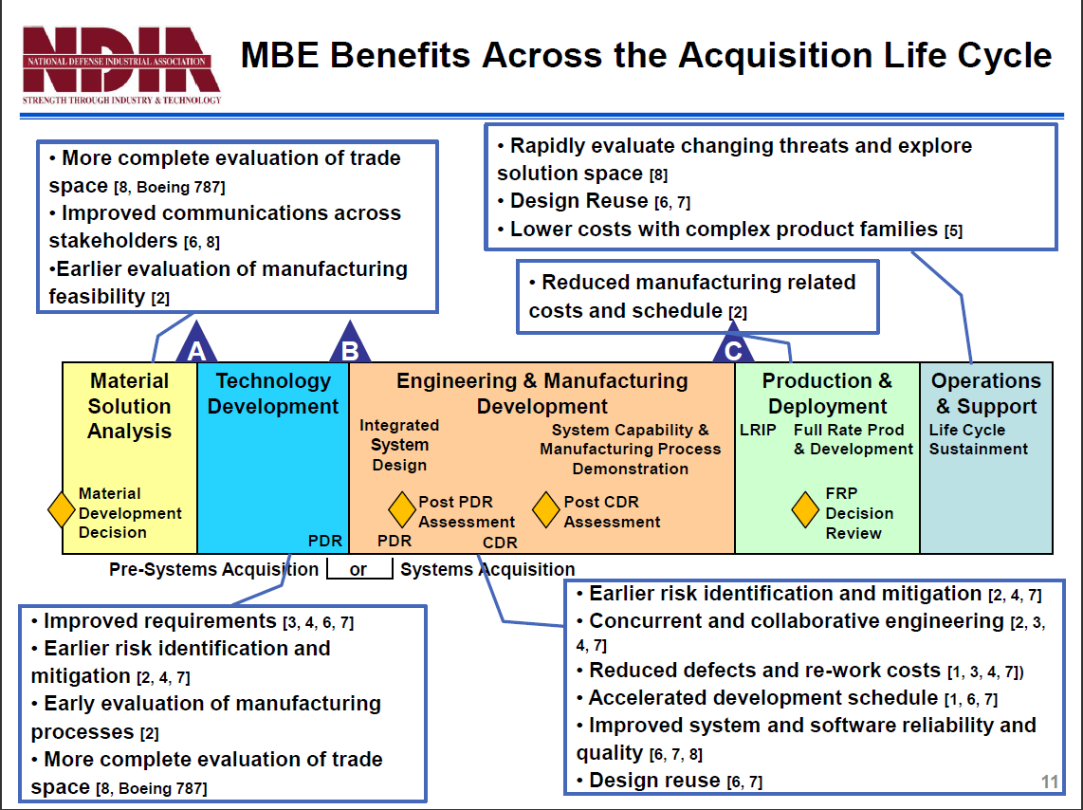
How should the practices and tools be integrated/coupled across disciplines?
Taking the results of the NDIA MBE studies…
Full life cycle context should be taken into account
Common tool repositories…not necessarily integrated, but interoperable and interdependent
Discipline Coupling
Primarily loose coupling…is more realistic given the separation of concerns
Interoperable implies…
Shared vocabularies
Common Representations
Transformations/Adapters
Inter dependent implies…
Traceability across disciplines

Slide 7
How should the practices and tools be integrated/coupled across disciplines? (cont.)
System Engineering
Electro/Mech
Engineering
Distributed
Infrastructure
Manufacturing
System Test
Support
System & Ops Requirements
Drawings
CAM
Models
Training Delivery
Logistics Support
I V&V
CAD
Models
Test Plans
Subsystem Requirements
Images
Tooling Data
Quality
Models
Procedures
Test Specs
Interface
Specifications
Part
Test Results
CLINs:
Equipment
Software
Tech Manuals
Spares
Training
CDRLs:
Design Docs
Production Docs
Test Results
E-BOM
Plans (SEMP)
Processes
S/W Engineering
S/W Code / Test
System & Element Architectures
S/W Architecture
S/W Top Level Design
S/W Code
SRS
Requirements
S/W Test Data
S/W Detailed Design
SSS Interface
Specifications
S/W Test Plan & Procedures
S/W Interface Design

Slide 8
How are the system, hardware, and software models managed to ensure an integrated technical baseline?
Two approaches are pervasive in the modeling environments to persist and manage models
File based
Repository based…emerging as the best practice for larger teams
Formal meta-models that define the semantics of the elements of each disciplines models
Standards and cross-discipline working groups
Transformation of the meta-models is enabled by including sufficient semantic representations (“meaning”) for each element and relationship between the elements

Slide 9
Thank you !

