Slide 1
Establishing Model Credibility Using Verification and Validation
Joe Hightower
Sr. Quality Engineer
Associate Technical Fellow
The Boeing Company
Phone: 425.753.4882
Email: joe.c.Hightower@boeing.com

Slide 2
Two goals
Provide an introduction to Verification and Validation in the Modelling and Simulation Context
Describe the ASME relationship to Verification and Validation and available resources

Slide 3
Introducing Verification and Validation
For Modelling and Simulation

Slide 4
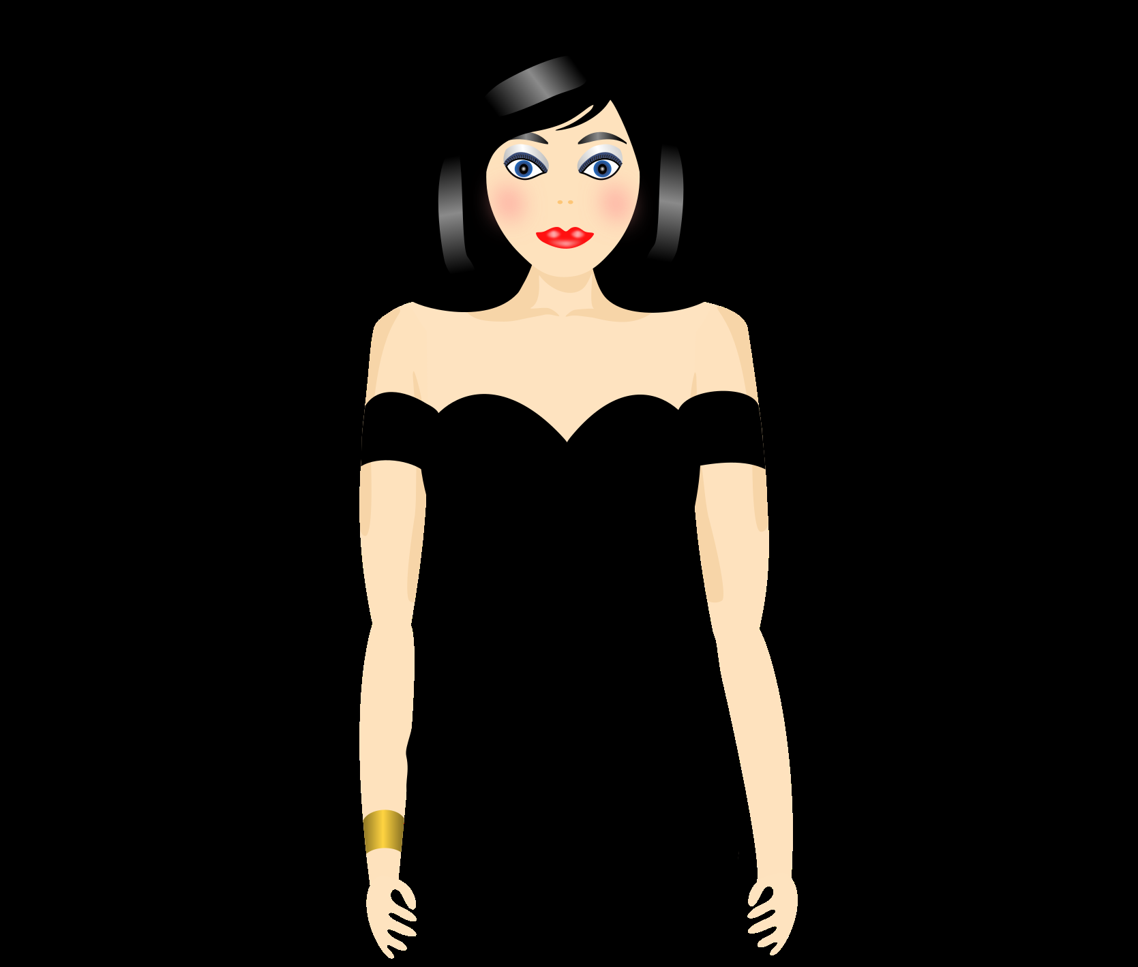
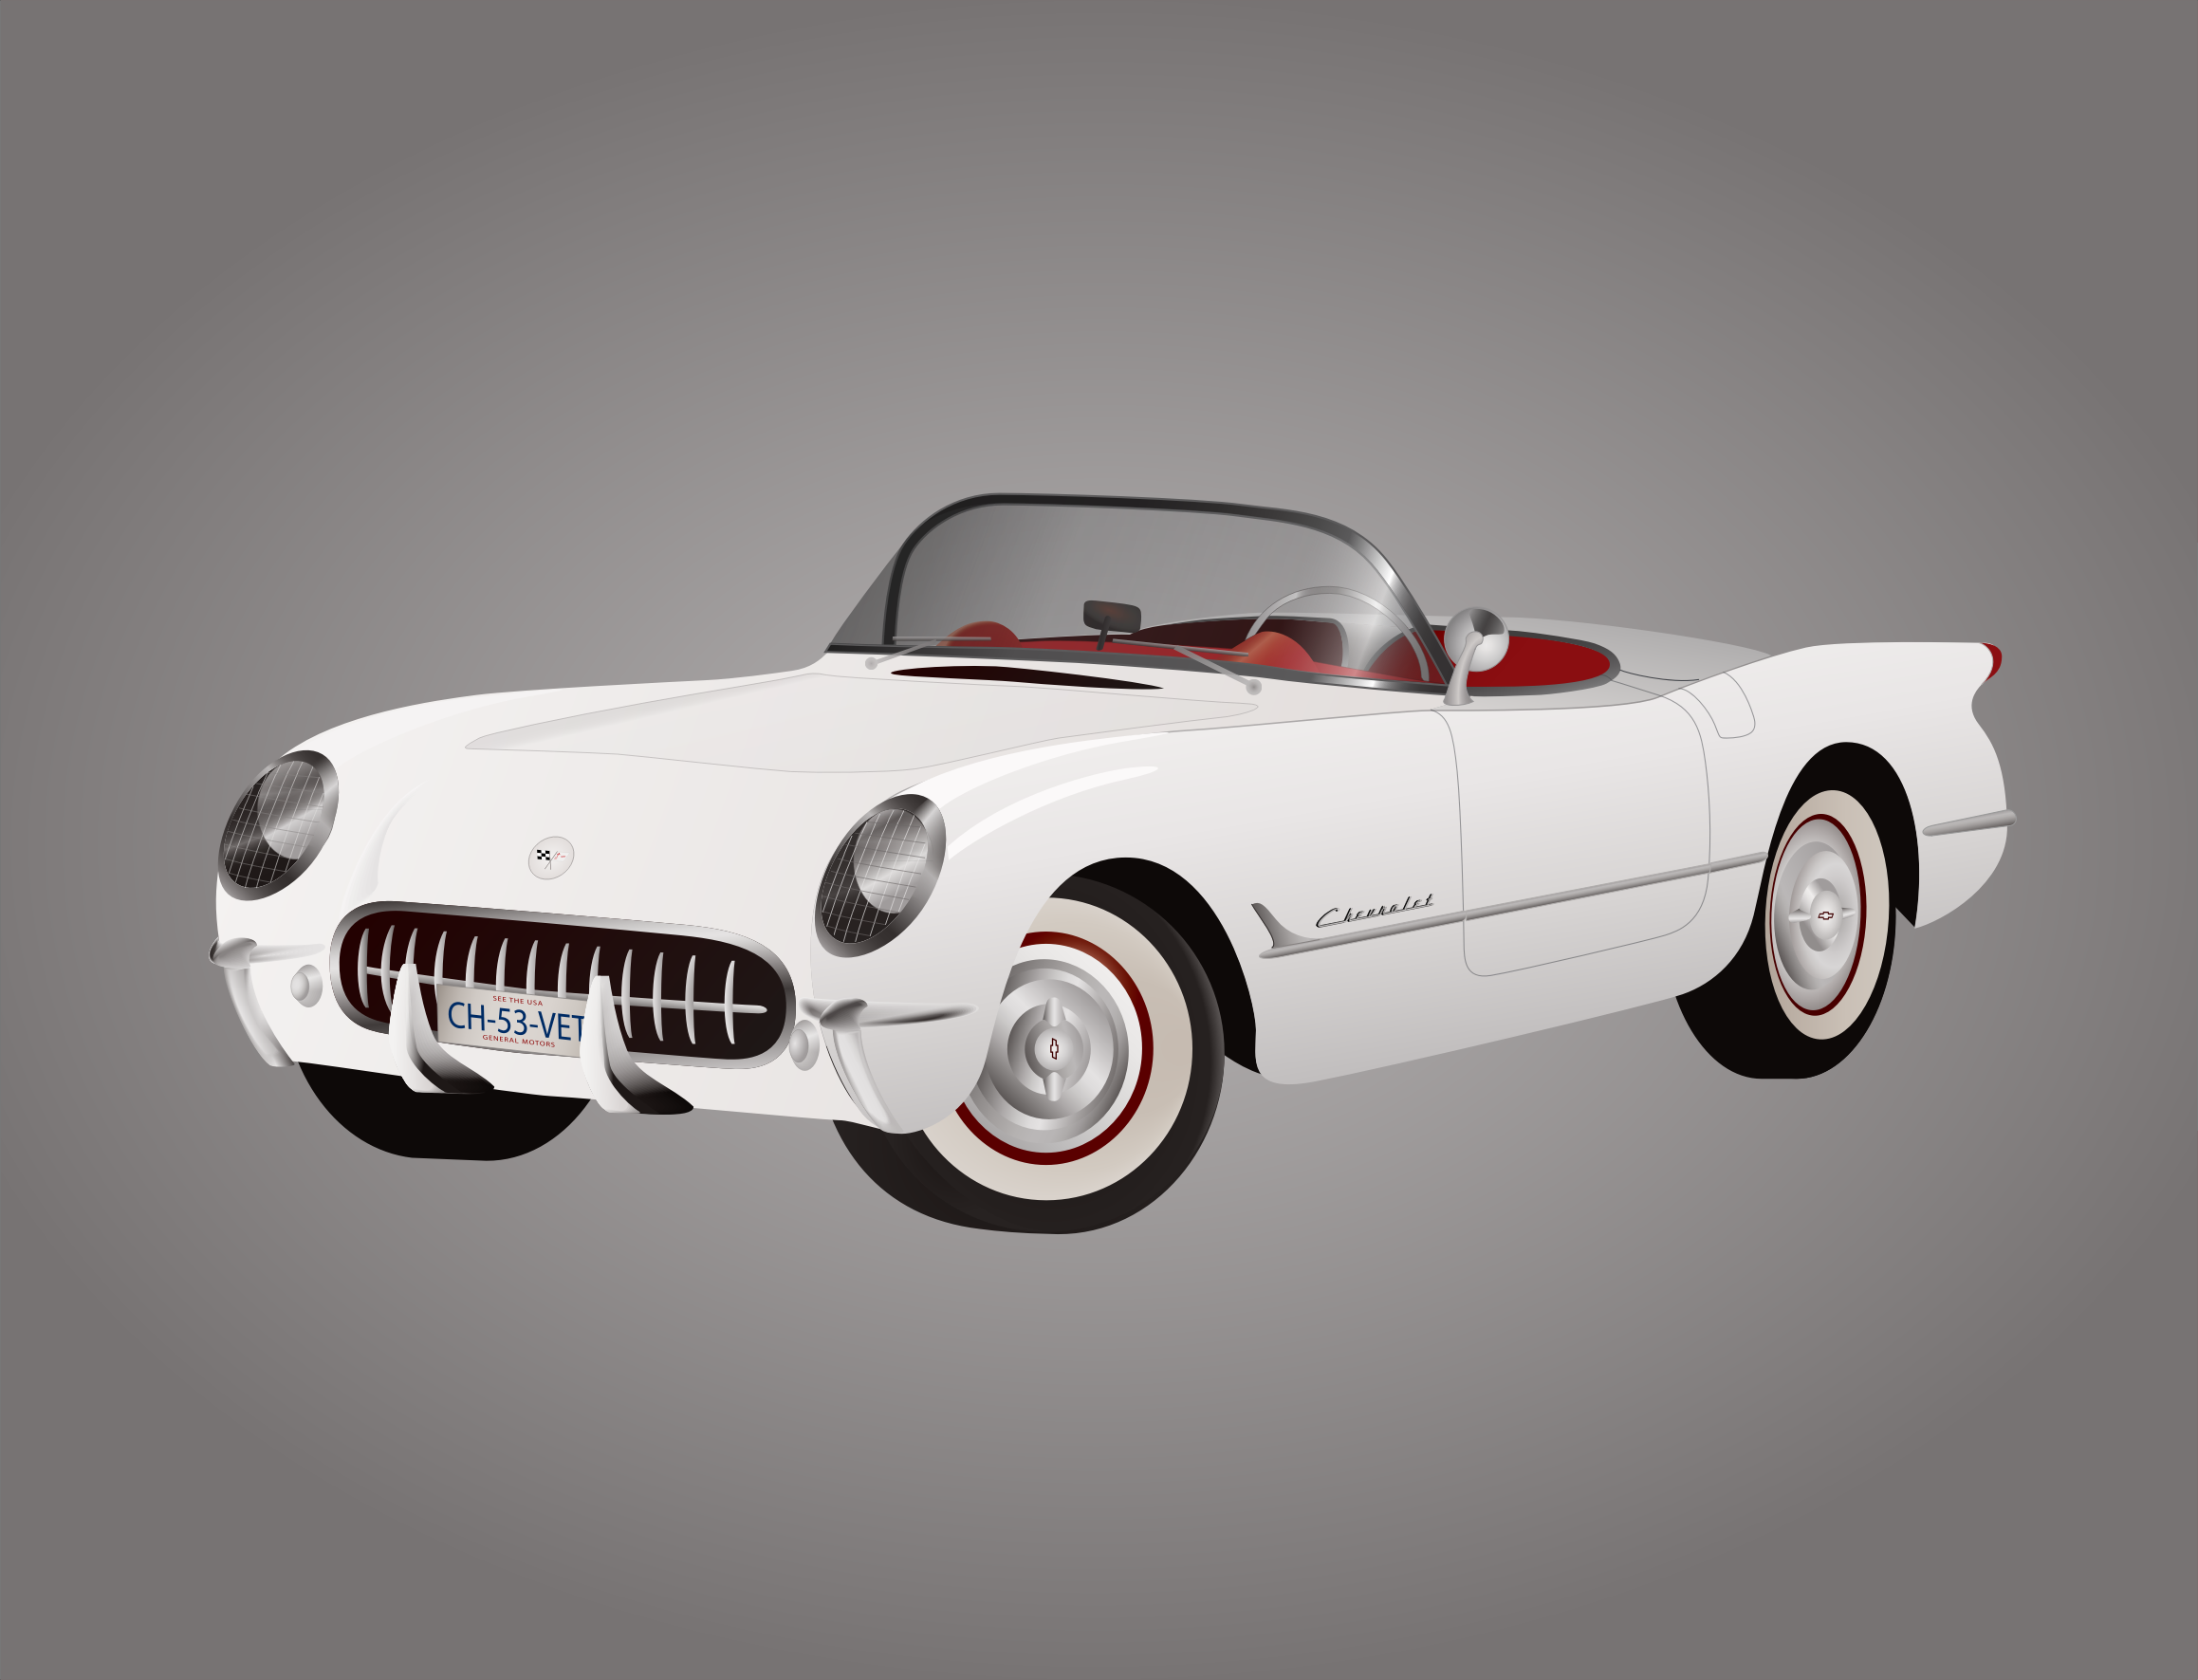
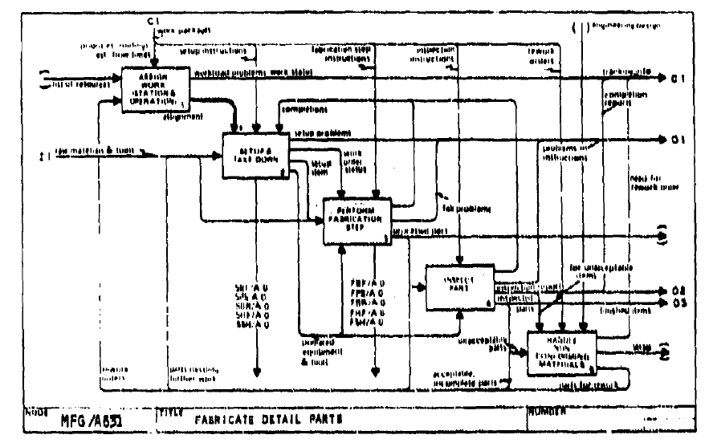
Models
$$Y=b_{o}+b_{1}∗X$$
Fashion Models
Engineering Models
Process Models
Mathematical Models
Visualize/Improve Understanding
Explain/Teach/Communicate
Answer Questions/Guide Decisions
Notes:
This slide communicates the purpose of models – in general
Models Are Ubiquitous
Many applications
Fashion models help communicate the design to an audience, seeking to induce them make a purchase decision
Engineering models – clay models of car bodies – visualize, adapt, educate, make a decision on accepting a design; wind tunnel models to test, learn, improve and support decisions
Process Models – capture and learn how a process works – communicate that process to others
Other models – many types, architectural models, artists models for statues and castings
Now Mathematical models – learn how parts of system, process etc work together, inputs required,
Three uses for models:
1) Learn 2) Communicate 3) Make Decisions
I will focus the rest of this part of my talk on decision making
INCOSE deals with a broad spectrum of models – including physical models and their impact on systems

Slide 5
Box and Draper “Empirical Model-Building and Response Surfaces”
“Remember that all models are wrong;
the practical question is how wrong do they have
to be to not be useful”
Notes:
1. Models are never perfect. They will always obscure the truth in some way. So we talk in terms of credibility. How do we measure credibility?
2. Credibility – how confident are we that we can rely on this model and the simulated outcomes are a valid basis for making a decision?
We tend to believe that the results are good, especially when we use software that is OTS
How do we determine whether our model is credible?

Slide 6
Making Decisions
2. Simulation Results
Uncertainty in Simulation
Probability of Decision Error
3. Risk from Error
Make a Decision
1. Targets &
Thresholds
Cost or
Impact of Error
Notes:
We need two things to make a decision: 1) The decision criteria and 2) the risk that making a bad decision will incur
Decisions can result in two types of mistakes: 1) The mistake that we believe that we will meet our goals, but after taking action we do not and 2) The mistake that we believe that we will not succeed, and in not taking action we miss an opportunity
Of course risk has two components: 1) The probability that we will make a bad decision and 2) the cost if we do
Various ways of estimating probabilities
The probabilities of decision error are directly linked to the All require quantifying uncertainty in the modeling and simulation process

Slide 7
What is Uncertainty?
V&V10 “Guide for Verification and Validation in Computational Solid Mechanics”
uncertainty: a potential deficiency in any phase or activity of the modeling, computation, or experimentation process that is due to inherent variability or lack of knowledge.
Notes:
Any of the model building process or model application that are subject to
Known and unknown
Systematic errors
Random errors
Uncertainty comes form the model building process or the model application
Systematic and random components
Measured and known (Aleatoric) and unmeasured and unknown (Epistemic)

Slide 8
Model Building Process
Conceptual Models
Descriptions and pictures
Mathematical Models
Equations relating inputs to outputs
Encoded Models
Convert Math into Executables
Simulate
Ask and answer Questions
Model form errors
Mistakes in translating the model into code
Errors in numerical approximation
Errors in inputs
Floating point errors
Notes:
Building a Model is a process – sources of uncertainty arise from the process of building a model

Slide 9
Verification and Validation
Verification
Solving the Equation Right
Validation
Solving the Right Equation
Mistakes in translating the model into code
Errors in numerical approximation
Errors in inputs
Floating point errors
Model form errors
Notes:
Now we define verification and validation
These definitions, if you examine them closely, are adapted from the ISO definitions for application to the Modelling and Simulation Problem

Slide 10
ASME and Verification & Validation
Leading the effort to develop V&V methodologies

Slide 11
ASME
VISION STATEMENT:
To be the world leader in mechanical and multidisciplinary engineering codes, standards, conformity assessment programs, and related products and services.
MISSION STATEMENT:
Develop the preeminent, universally applicable codes, standards, conformity assessment programs, and related products and services for the betterment of humanity. Involve the best and brightest people from around the world to develop, maintain, promote, and employ ASME products and services globally.
Notes:
In the vision statement highlight the multidisciplinary aspect

Slide 12
ASME Activity In V&V
Past 30 years - leading the development of methods for assessing measurement uncertainty
Current Standard is ASME PTC 19.1-2005 Test Uncertainty Standard
Past 20+ years leading the development of methods for code and solution verification and validation
Numerical uncertainty quantification
Simulation Validation
Resulting in
Three current Standards
Verification and Validation Symposium
Verification and Validation Journal

Slide 13
Current Publications

Slide 14
V&V Symposium
The first large-scale symposium dedicated entirely to Verification, Validation, and Uncertainty Quantification of Computer Simulations
Multidisciplinary discussion and exchange of ideas and methods for Verification and Validation in Computer Simulations
Held every May; 2017 Meeting is scheduled for May 3-5, 2017

Slide 15
V&V Journal
V&V Journal
Launched 2016
V&V Committee serves in advisory role to Journal
Has published 4 Issues to date

Slide 16
ASME Structure
Verification & Validation Standards Committee
V&V 10 Verification and Validation in Computational Solid Mechanics
V&V 20 Verification and Validation in Computational Fluid Dynamics and Heat Transfer
V&V 30 Verification and Validation in Computational Simulation of Nuclear System Thermal Fluids Behavior
V&V 40 Verification and Validation in Computational Modeling of Medical Devices
V&V 50 Verification and Validation of Computational Modeling for Advanced Manufacturing
V&V 60 Verification and Validation in Modeling and Simulation in Energy Systems and Applications
Technology Specific
Cross-Industry Applications
Computational Problems

Slide 17
ASME V&V 50
*Advanced Manufacturing, as defined in the PCAST report:
“Advanced manufacturing is a family of activities that (a) depend on the use and coordination of information, automation, computation, software, sensing, and networking, and/or (b) make use of cutting edge materials and emerging capabilities enabled by the physical and biological sciences, for example nanotechnology, chemistry, and biology. It involves both new ways to manufacture existing products, and the manufacture of new products emerging from new advanced technologies.”
—President’s Council of Advisors on Science and Technology Report to the President on Ensuring American Leadership in Advanced Manufacturing - 2011
To provide procedures for verification, validation, and uncertainty quantification in modeling and computational simulation for advanced manufacturing.*

Slide 18
V&V 50 Scope
New Technologies
Existing Technologies
V&V 50 Working Groups
Advanced Manufacturing
Areas of Application
Model Types
Data Driven
Physics based
Hybrid
Process Development
Process Control
Quality Control
Notes:
Additive Manufacturing

Slide 19
V&V 50 working groups
V&V 50 Working Groups
VVUQ Applications in Process Technologies
VVUQ Challenges and Methods in Systems of Models
VVUQ Methods in Data-driven and Hybrid Models
Terminology, Concepts, Relationships and Taxonomy for VVUQ in Advanced Manufacturing
V&V Interactions with the Model Life Cycle

Slide 20
ASME - INCOSE interface
Potential INCOSE interactions with ASME
Use current standards where appropriate for the problem
Study the framework developed and adapt to other modelling problems
Engage in relevant standards development
Potential opportunities for Co-development for other modeling problems relevant to Systems Engineering

