Slide 1
(MBSE)² : Using MBSE to Architect the MBSE System
Ryan Noguchi
The Aerospace Corporation
ryan.a.noguchi@aero.org
January 2020
Approved for public release. OTR 2019-01189.

Slide 2
The MBSE System
Implementing MBSE involves integration of many interdependent pieces
Descriptive models
Analytical models
Design models
Databases
PLM/ALM tools, RM tools, etc.
These pieces should not be developed in isolation
They should be architected into a coherent MBSE System
As with any non-trivial system, use systems engineering to architect and implement it
Treat MBSE as a System to be developed with disciplined SE
… perhaps even using MBSE

Slide 3
Comparing the MBSE System to the Real System
Structure and Requirements
 | The Real System
Functional Requirements | What must it do?
Performance Requirements | How well must it do it?
Structure | What system components comprise it? How are those components connected?
Requirement Traceability | Requirements trace to higher requirements
Requirement Allocation | Requirements are allocated to sets of system components
Requirement Verification | Test events verify requirements Test events require components, facilities, test equipment, etc.
The MBSE System
What questions must it answer?
How well must it answer them?
What model components comprise it? How are those components connected?
Questions trace to higher questions and to the decisions they should inform
Questions are answered by sets of model components
Model views answer questions for humans Model views require model components, tool infrastructure, etc.
The MBSE System is itself a System
… amenable to Systems Engineering
… and perhaps also MBSE

Slide 4
The MBSE System and the (MBSE)² System
MBSE for the Real System is implemented in an MBSE System
Real System
MBSE System
for the Real System
MBSE System
for the MBSE System for the Real System
Model of the
Real System
Model of the
MBSE System
for the Real System
MBSE System
(MBSE)² System
MBSE for this MBSE System is implemented in an (MBSE)² System

Slide 5
Why Model the MBSE System?
The modeling process can improve discipline in executing the architecting process
The model of the MBSE System can help with managing the complex network of dependencies within the model of the Real System
Components of the (MBSE)² System can be linked to their counterparts in the MBSE System in the same modeling environment
The experience of modeling the MBSE System can arm acquisition offices with valuable experience in modeling processes, methods, and tools in advance of the formal acquisition
And aid in the creation of model-based requirements to support that acquisition
MBSE can add value to the implementation of MBSE

Slide 6
System Architecting Process
Aerospace System Architecting Method (ASAM)
Purpose Analysis
Problem Space
Exploration & Refinement
Solution Space
Exploration & Refinement
Harmonization & Analysis
Decision Support
Architecting is a nonlinear process intended to illuminate tradeoffs to better inform decisions

Slide 7
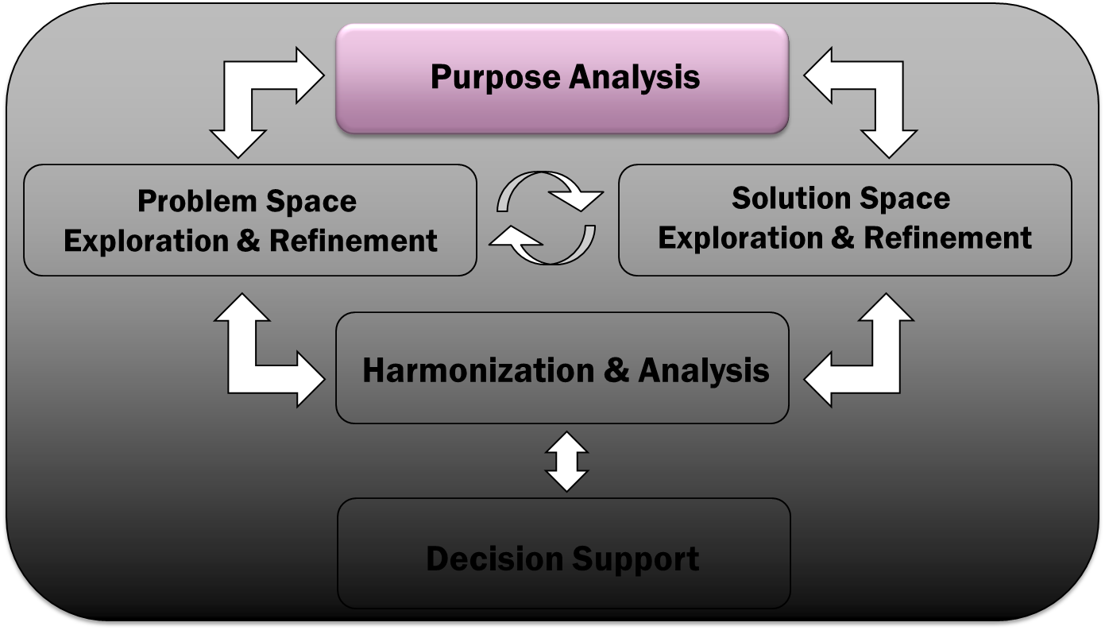
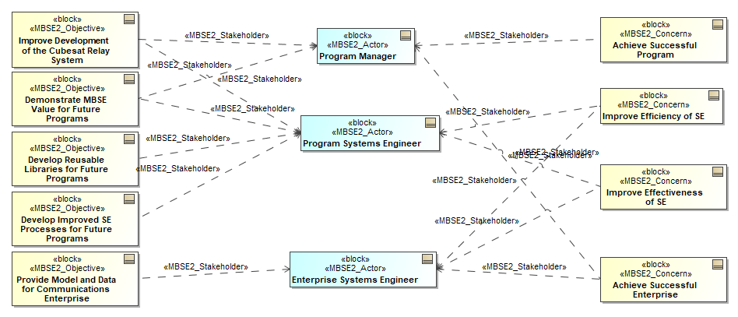
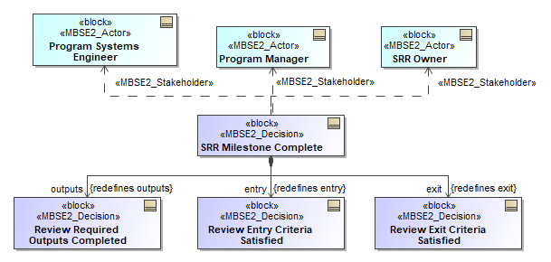
Architecting the MBSE System
Purpose Analysis
Define high-level Objectives for the MBSE System
i.e., What are the reasons for implementing MBSE?
Improve development of the Real System?
Improve operation of the Real System?
Advance the practice of MBSE?
Identify key Actors for the MBSE System
Includes all stakeholders for the Real System
For each Actor, identify their key Concerns
Each part of the MBSE System should be traceable to important Objectives, Concerns, and Actors
(MBSE)² models the Purposes of the MBSE System to connect the modeling effort to its value to stakeholders

Slide 8
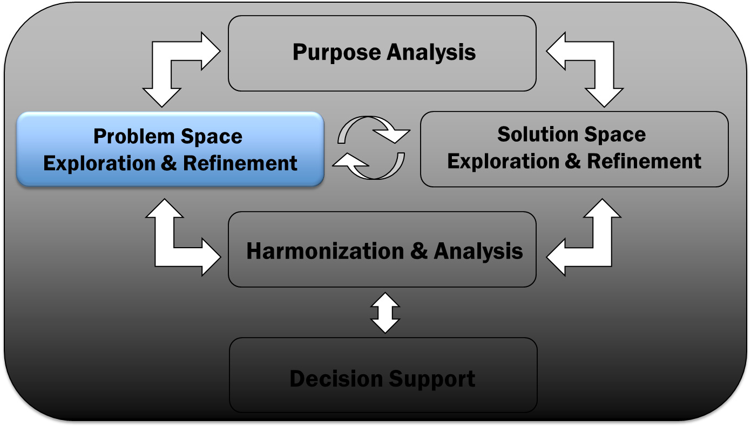
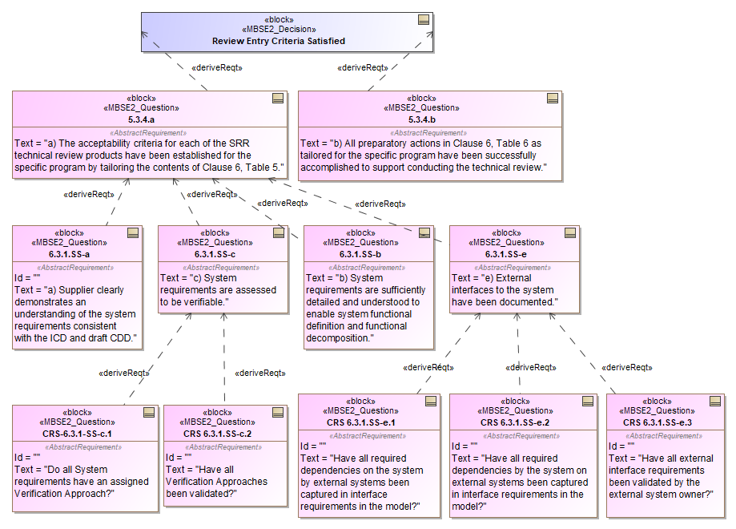
Architecting the MBSE System
Problem Space Exploration & Refinement
Identify key Decisions about the Real System
Key program milestones
Key programmatic decisions
Key operational decisions
For each Decision and each Concern, identify the Questions that need to be answered
Questions may be chained into (or derived from) process workflows
Every part of the MBSE System should be traceable to (answer) one or more Questions
Problem Framing Workshops* found to be effective for fleshing out the problem space
* See James Martin, Problem Framing - Identifying the Right Models for the Job, INCOSE International Symposium, Orlando, FL, 2019
(MBSE)² models the Problem Space of the MBSE System to define the Questions the models need to answer

Slide 9
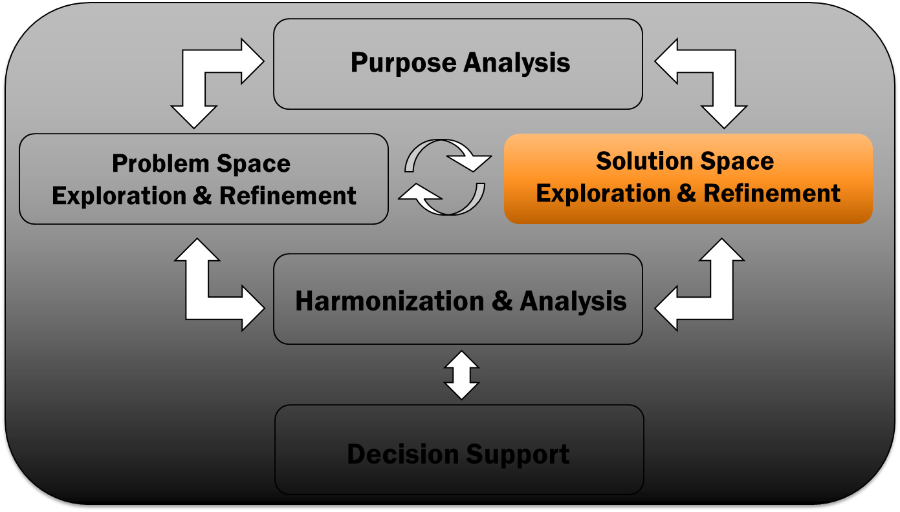
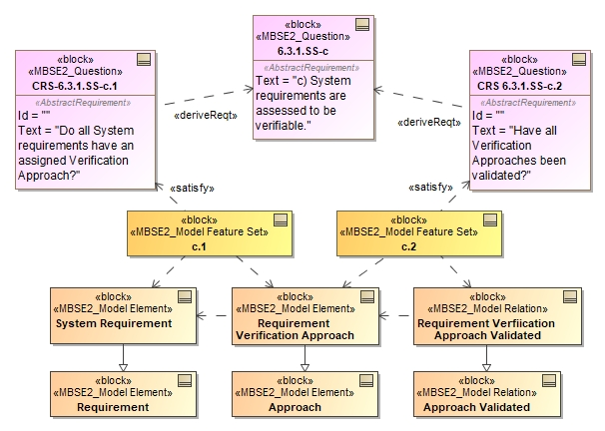
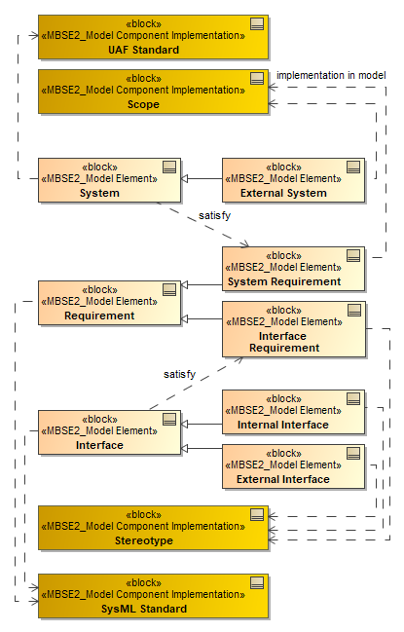
Architecting the MBSE System
Solution Space Exploration & Refinement
Identify the complete Feature Sets of Model Components needed to answer each Question
Model elements, relationships, attributes, metadata
Create a Conceptual Model of the Model Components
Documents how they should be used together
Identify useful subsets of the total Scope of Model Components
Answer Questions incrementally by incrementally implementing scope
Subset of elements or relationships
Depth of dependency chain
(MBSE)² models the Solution Space of the MBSE System to identify model components that are needed

Slide 10
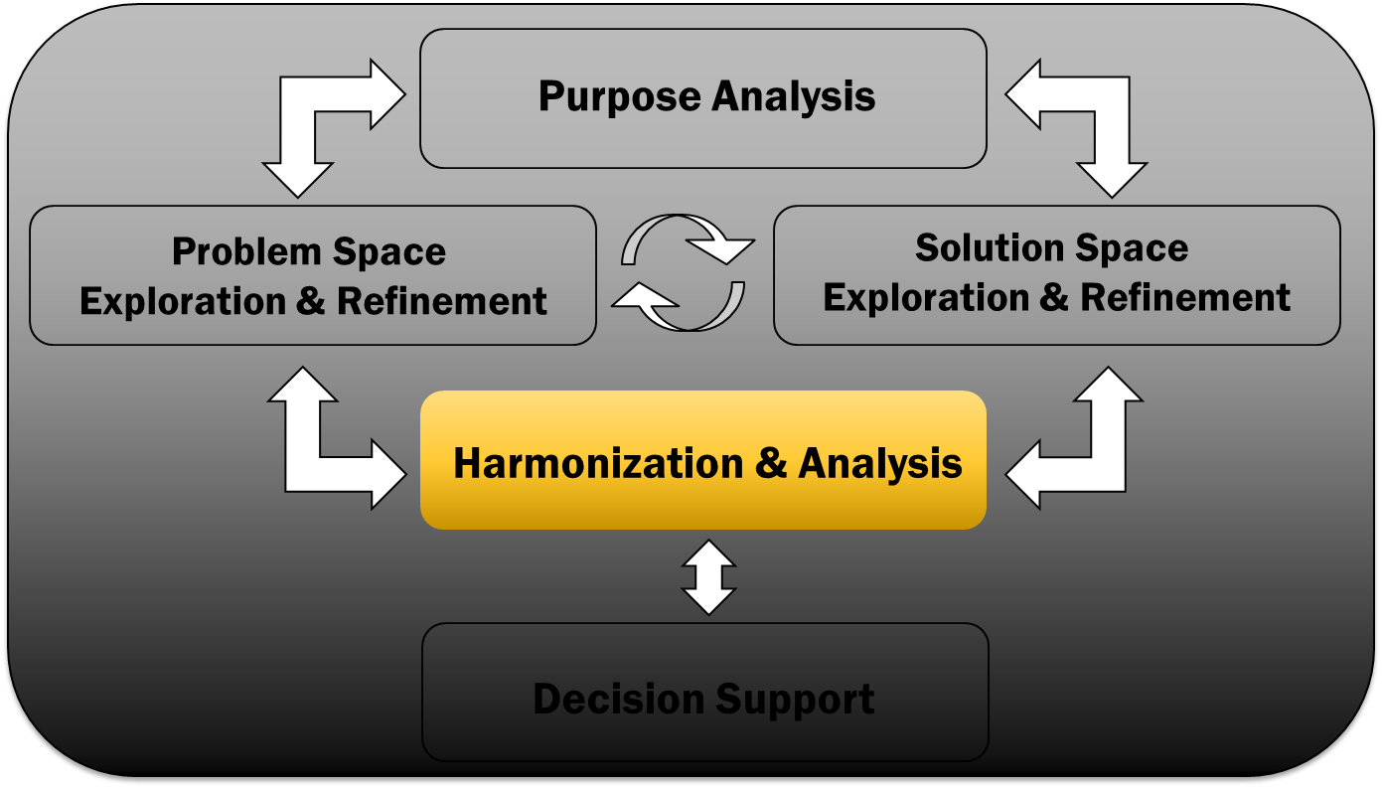
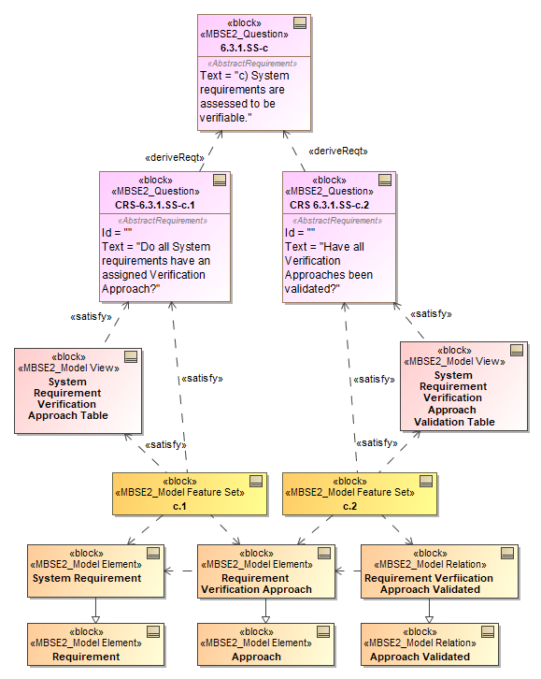
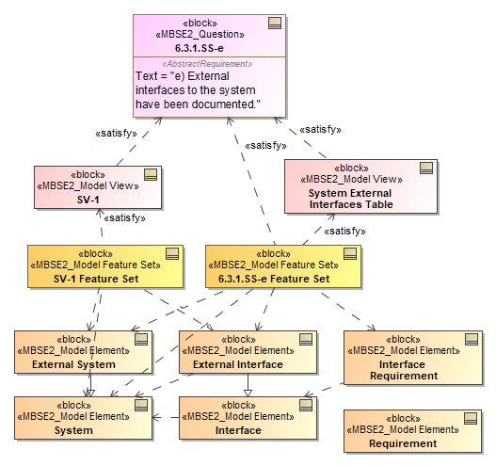
Architecting the MBSE System
Harmonization and Analysis
Identify the View that answers each Question
Identify Model Components needed
If more than one View is needed to answer a Question, the Question may be at too high a level
Identify needed Model View Construction Components to create views
Query language constructs
Report templates
Metachain or constraint expressions
Automation scripts
Model Components and Model View Construction Components comprise the Feature Sets needed to complete a View
(MBSE)² models the Harmonization of the MBSE System to define “work packages” needed to answer Questions

Slide 11
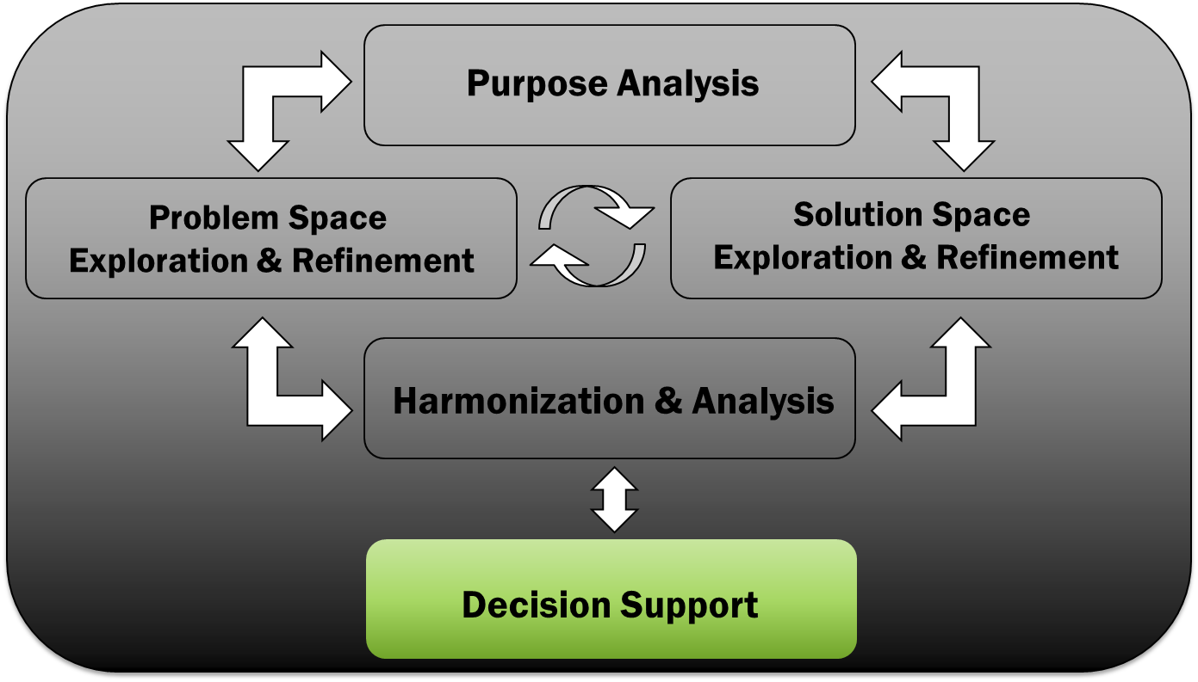
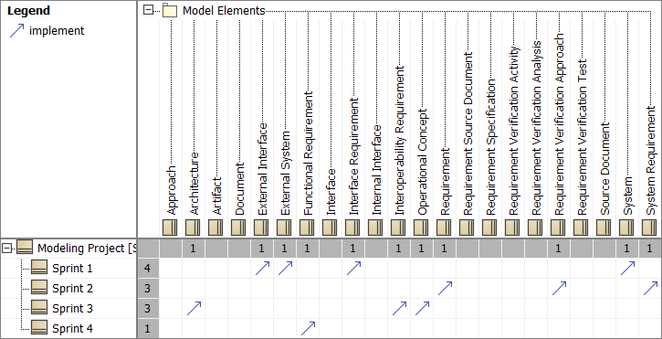
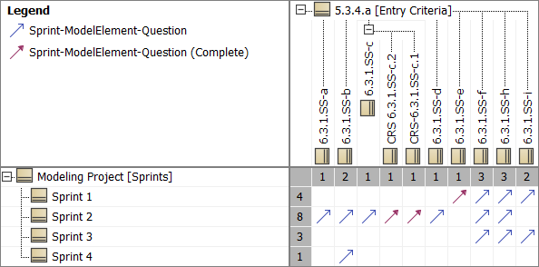
Implementing the MBSE System
Decision Support
Decide what to Build and Plan the Modeling Effort using Agile development principles
Develop an Initial List of Questions, Views, Components, etc.
Choose and prioritize Questions to be answered
Prioritize Feature Sets to be built to answer the Questions
Decide scope of each sprint—answer one or more Questions per sprint
(Backlog)
(User Stories)
(Features)
(Sprint planning)
Use agile development methods to implement the MBSE System to provide rapid learning and feedback

Slide 12
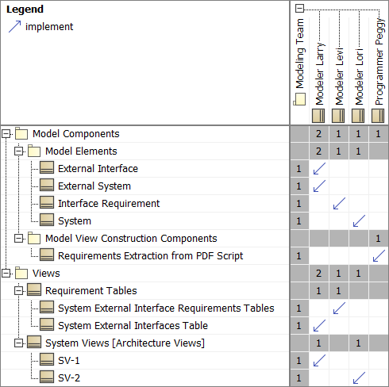
Managing the Implementation of the MBSE System
The (MBSE)² System as a Development Dashboard
Execute the plan using Agile development principles
Monitor progress using the (MBSE)² System
Impact analysis, coverage/gap analysis
Measure progress by Questions answered
Quantity
Quality (scope, depth, fidelity)
Solicit feedback from Question owners
Adjust (MBSE)² model based on feedback and learning
Update backlog and modeling plan based on evolving knowledge
Use the (MBSE)² model to inform and manage the model development process

Slide 13
Staggered Streams Enables Agile Development
Objectives, Stakeholders, Concerns
Purpose Analysis
Decisions, Questions
Problem Space
Views
Model Components: Elements, Relations, etc.
Solution Space
Model Views, Model View Construction Components
Harmonization
Modeling Plan
Decision
Modeling Pathfinder
Modeling Execution (and Monitoring)
Modeling Pathfinder Feedback
Model Operation (and Feedback)
Time
Stream starts do not need to be synchronous
All streams continue through life of MBSE System
Use Pathfinders to bootstrap the effort and avoid “analysis paralysis”
Staggered application of ASAM facilitates agile development of the MBSE System with continuous evolution

Slide 14
Operating the (MBSE)² System
Example Use Case: Model Based Systems Engineering Reviews
Source Material (Requirements, Architecture, CONOPS, Test Plans, etc.)
Static artifacts go “stale” quickly,
Static artifacts are easily misinterpreted
Static artifacts grow in inconsistency
Models are the life-blood of knowledge management—always current
Models are rigorously defined with far less ambiguity
Models have automated enforcement of internal consistency
Review Events (e.g., SRR, SDR, PDR, CDR, etc.)
Discrete events separated by many months
Discrete large data drops
Changes implemented offline; delta events
Success criteria inconsistently interpreted
Continuous, proactive assessment, minimizing time to discover defects
Comprehensive assessment of linked data across the enterprise
Changes implemented immediately, enabling quicker impact assessment
Success criteria are consistently applied and proactively drive knowledge/model creation

Slide 15
Operating the (MBSE)² System
Example Use Case: Model Based Systems Engineering Reviews
Objectives
Define knowledge to be assessed for maturity at each milestone
Provide to contractors as “requirements” for model creation and delivery
Facilitate orderly review of knowledge against success criteria
Adapt quickly to evolving knowledge
Use modeling tools to perform impact and coverage analysis
Actors (Stakeholders and Beneficiaries)
Program Manager
Program Systems Engineer
Enterprise Systems Engineer
Program Review Owner
MBSE System Modelmaster(s)
Subject matter experts (SMEs)
Concerns
All questions (review success criteria) answered?
Risks identified, quantified, and adjudicated?
Implications to enterprise identified (and acceptable)?
Decisions
Has the milestone been successfully achieved?
Are tradeoffs identified and understood?

Slide 16
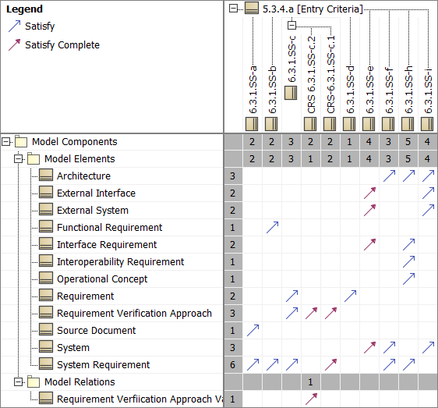
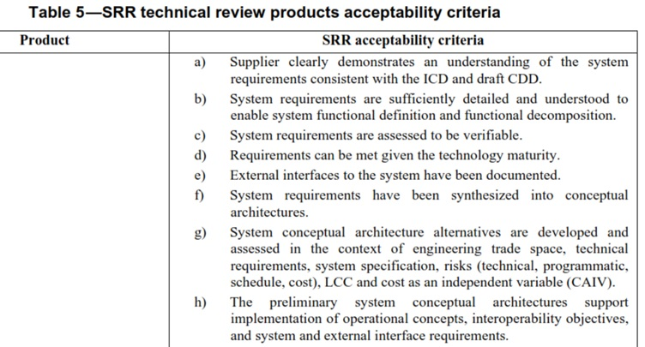
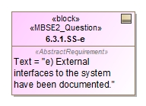
Operating the (MBSE)² System
Example Use Case: Model Based Systems Engineering Reviews
Questions
Define success criteria for the review
Refine criteria until clear how to verify satisfaction
Model Components
Define needed model content to answer each question
Ref: ISO 15288.2 Standard

Slide 17
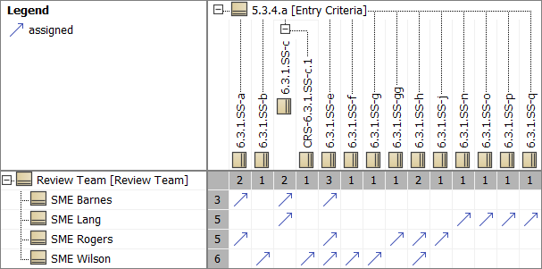
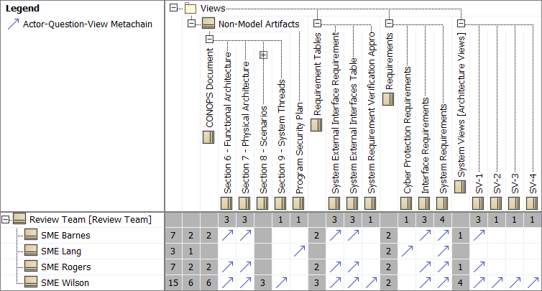
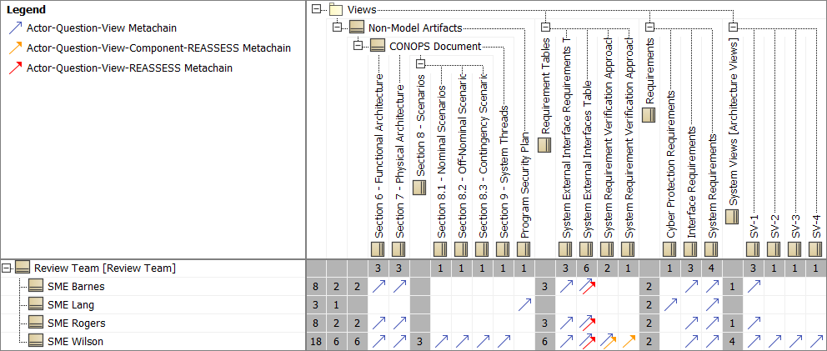
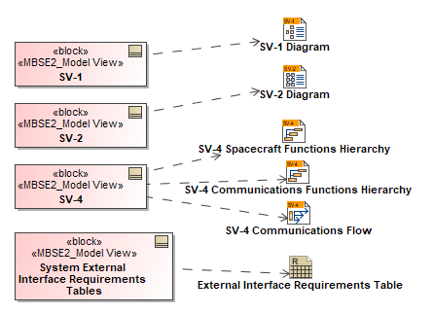
Operating the (MBSE)² System
Example Use Case: Model Based Systems Engineering Reviews
Assign Questions to reviewers
Determine Views reviewers need to review
Link Real System model to MBSE System model
Assess and track Review completeness
Coverage analysis, impact analysis, etc.
As the Real System model evolves, (MBSE)² model reveals potential impacts to the MBSE System to trigger reassessments

Slide 18
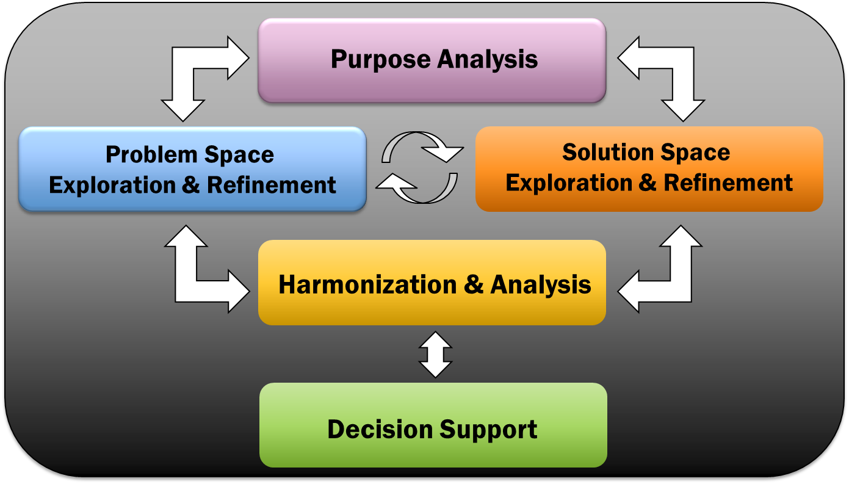
Key Takeaways
Implementing MBSE is really implementing an MBSE System
Apply system architecting methods to architect the MBSE System
Use an agile process to architect, implement the MBSE System
Staggered parallel processes facilitate continuous progress, feedback, and evolution
An (MBSE)² System model can facilitate management of complexity & traceability
Link the MBSE System with the (MBSE)² System
Use the (MBSE)² System to manage the implementation of the MBSE System
Use the (MBSE)² System to operate the MBSE System
Use MBSE to architect and implement MBSE

