Slide 1
Multi-Disciplinary Mechanical Modeling, Management and Exchange
Clark Briggs
ATA Engineering
Clark.Briggs@ata-e.com
(909) 626-6364
1/17/2012

Slide 2
Content Structure
Model standards for exchange
AP209, HDF5, CGNS, Nastran deck, …
Management
Model and data management
Process management
Collaborative environments
Multidisciplinary Integration
Separable, serial, bucket brigade
Optimization frameworks
CoSimulation, timestep-by-timestep integration
Solution process knowledge is in the executables

Slide 3
Discipline Scope Addressed
Mechanical Analysis
Performance Estimation
Stress, dynamics, heat transfer,
Coupled with
Fluids for heat transfer, loads, deformed shape
Control systems
Propulsion, RF/optics, ECAD thermal
But not…
Design CAD, electrical/avionics, software, magnetics
Why? Author’s limited experience & limited time to prepare. Nothing fundamental behind the limitations and exclusions.

Slide 4
Model Exchange Standards
Descriptive models

Slide 5
STEP AP-209
STEP AP-209 is one of the Application Protocols
Modular AP Domains
AP203 Mechanical CAD (parts & assemblies)
AP209 CAE (FEA and CFD)
AP210 EDA/MCAD (electrical and mechanical assemblies)
AP233 Systems Engineering
AP239 Product Life Cycle Support (PLCS)
Source: Charlie Stirk, PDES Inc., “STEP Implementation”, NIST_STEP_TDP2010.pdf
And http://www2.pdteurope.com/media/54176/5. step in the usa – an update from pdes inc.pdf, 2010

Slide 6
CAx Implementer Forum
www.cax-if.org
Bi-annual rounds of testing of CAD data exchange
Cooperate on implementing STEP
Accelerate translator development
Promote interoperability
Scope is AP203 and AP214
Joint testing effort of PDES Inc. & ProSTEP iViP with software industry participants
Current test cases includes Composites
Used with AP209ed2 for CAE
Source: Charlie Stirk, PDES Inc., “STEP Implementation”, NIST_STEP_TDP2010.pdf

Slide 7
High Level AP209ed2 Composition
Source: http://cms3.dynaweb.nl/users/esa//docs/10C08_SECESA_2010/jotne---secesa-simdm.pdf

Slide 8
AP209ed2 Multidisciplinary Analysis and Design
Combines CAD, CAE, PDM capabilities
Superset of AP203ed2
Finite Element Analysis (FEA)
Computational Fluid Dynamics (CFD)
General numerical analysis
Shares base analysis models with AP233 Systems Engineering
Developing binary API
Based on open source HDF5 toolkit
Simulation Data Management (SimDM) project
Analysis data management
Repository for archiving
Interfaces to commercial and proprietary simulation tools
Joint LM Aero and Jotne/EPM Technologies project
Source: Charlie Stirk, PDES Inc., “STEP Implementation”, NIST_STEP_TDP2010.pdf

Slide 9
Analyses in AP-209
Finite Element Model, 2-D or 3-D
Node representation
Unique ID with point representation
May be in a node set
May be related to design geometry
Element representation
Unique ID with list of node representations
May have geometric aspects eg face, edge, or volume
Has element coordinate system
Has property representations
AP 209ed1 supports linear static and linear dynamic analyses
Case and step controls
Constraints for single nodes, groups, and linear constraint equations
Analysis results
States for: known a priori, calculated result, linearly superimposed, output request
Result information represented by 2-D and 3-D field variables
Information such as notes, warnings or errors represented by messages
May be related analysis reports represented as documents
Source: “Recommended Practices AP209,” v1a, PDES, Inc., 1999
http://www.steptools.com/support/stdev_docs/express/ap209/recprac209v1a.pdf

Slide 10
Source: “Recent Developments in STEP”, Charlie Stirk, Collaboration & Interoperability Conference, 17-20 May, 2009, http://www.3dcic.com/2009-proceedings-audio/recent-developments-in-step

Slide 11
AP-209 ed 2
Renamed Multidisciplinary Analysis and Design
Incorporates CFD based on CGNS
Generalized structured and unstructured analysis and mesh capabilities developed in EU
Complete discrete/continuous mathematical field representation capability based upon the David Talyor Labs/Boeing DT-NURBS package

Slide 12
AP-209 Status
AP-209 approved 1994
AP-209ed2 approved 2010
CAx-IF (with NAFEMS) testing circa 2002
LM Aero and Jotne/EPM Technologies of Norway are developing an open, standards-based (using AP209 ed2) Simulation Data Manager named SimDM.

Slide 13
CFD General Notation System (CGNS)
General, portable, and extensible standard for the storage and retrieval of CFD analysis data
Collection of conventions, and free and open software
Designed to facilitate the exchange of data between sites and applications, and to help stabilize the archiving of aerodynamic data
Platform independent API for implementation in C, C++, Fortran and Fortran90
Principal target is compressible viscous flow (i.e., the Navier-Stokes equations), and subclasses such as Euler and potential flows
HDF5 is the default (official) data storage mechanism to enable parallel I/O
Source: “What is CGNS?,” http://cgns.sourceforge.net/WhatIsCGNS.html

Slide 14
NASTRAN Data Deck
De facto standard for structural FEA model transfer
Bulk data deck is declarative definition
Node ID, location, degrees of freedoms
Element ID, nodes, property ID
Loads and boundary conditions
Case control deck is process parameter definition
Organization of loads, sequences, parameters
Good commonality still remains
Divergence between MSC and SPLM since 2004 divestiture
Exchange participants do need content agreement

Slide 15
HDF5
Data model, library, and file format for storing and managing data
Flexible and efficient I/O
For high volume and complex data
Completely portable file format
High-level API with C, C++, Fortran 90, and Java interfaces
Range of computational platforms, from laptops to massively parallel systems
Commercial software supporting HDF5
Matlab, EnSight, ParaView, …
Source: “HDF Group – HDF5, What is HDF5?,” http://www.hdfgroup.org/HDF5/whatishdf5.html

Slide 16
Simulation Data Management

Slide 17
Overview
Data Management Scope
Analysis data sets, files, reports
Source data (design geometry, material defs, …)
Results data files, viewables, summaries
Process, execution, orchestration, tool integration
Application Scope
Geographical: Departmental, single site, enterprise, global
Business: Internal projects, OEM-Tier 1 Suppliers, collaborators
Duration: Work in Process, Release, Archive, Long Term Archival
Life Cycle Phases follow Product
Proposal, Concept
Design, Test
Operations, Maintenance

Slide 18
Commercial Offerings
ANSYS – Engineering Knowledge Management
Dassault – Simulia Simulation Lifecycle Management
MSC.Software – SimExpert/SimManager
Siemens PLM – Teamcenter for Simulation
Altair – Altair Data Management
Source: “Simulation Data & Process Management – Vendor Scorecard,” Collaborative Product Development Associates/CIM Data, Dec 2009.

Slide 19
STEP AP237 Product Life Cycle Support (PLCS)
ISO 10303-239-CD edition 2 2009
An international standard
Rich information model
Activities, plans, schedules, design data, …
Covers product life cycle
A standards based exchange model
Deployment modes
Point to point translators
Collaboration hub
Source: “What is PLCS -STEP AP239?,” Bodington and Houbaux, PDT Europe, 11/16/2009 http://www2.pdteurope.com/media/54152/1a. what is plcs - step ap239.pdf

Slide 20
Example: PLCS Information Model
Source: “What is PLCS -STEP AP239?,” Bodington and Houbaux, PDT Europe, 11/16/2009 http://www2.pdteurope.com/media/54152/1a. what is plcs - step ap239.pdf

Slide 21
Model Management Challenges
Common w/ Enterprise Data Management
Security, access control, integrity
Fragmented data management systems
Globally dispersed organization w/ business partners
Modeling Related
Wide variety of file types with little standardization
Large file sizes (> 1Gb solution files)
Few standardized processes, e.g. change control

Slide 22
Multidisciplinary Integration

Slide 23
Serial Integration aka “Bucket Brigade”
Applicable to coupled but separable physics
Product of first analysis is input to second analysis
Examples
Precision structure borne optical systems
Thermally driven structure fatigue life prediction
Quasi static analysis where one domain is quite fast relative to the other.
Implementation approach
Use stand alone solver for first domain
Transfer output solution to input for second solver

Slide 24
Loosely Coupled
Cyclically coupled where the output of one solution drives the input to the other, but that response affects the first domain.
Not separable and serially solvable
Amenable to iterative, cyclic solution
Assume an input and run the sequence to compute an updated starting point
Requires strong/good enough convergence
Examples
Deformed aircraft wing shape under static aerodynamic loads

Slide 25
Optimization Frameworks
Framework for integration of a wide variety of existing analysis tools
Commonly applied to optimization of performance
Captures and automates an analysis process
Seeks to leverage existing tools as black boxes
Executed via invocation commands
Manipulate parameters exposed in input decks and commands
Commercial products
ModelCenter, Phoenix Integration, http://www.phoenix-int.com/software/phx_modelcenter_10.php
SIMULIA Execution Engine (formerly Engineous Fiper), http://www.simulia.com/products/see.html
Workspace, Comet Solutions, http://cometsolutions.com/products/workspace/

Slide 26
Example: Phoenix Integration ModelCenter
Source: “An Approach to Multidisciplinary Design, Analysis & Optimization For Rapid Conceptual Design,” A. Carty, Paper AIAA-2002-5438, http://www.phoenix-int.com/documents/pubDownload.php/MDOforRCD.pdf

Slide 27
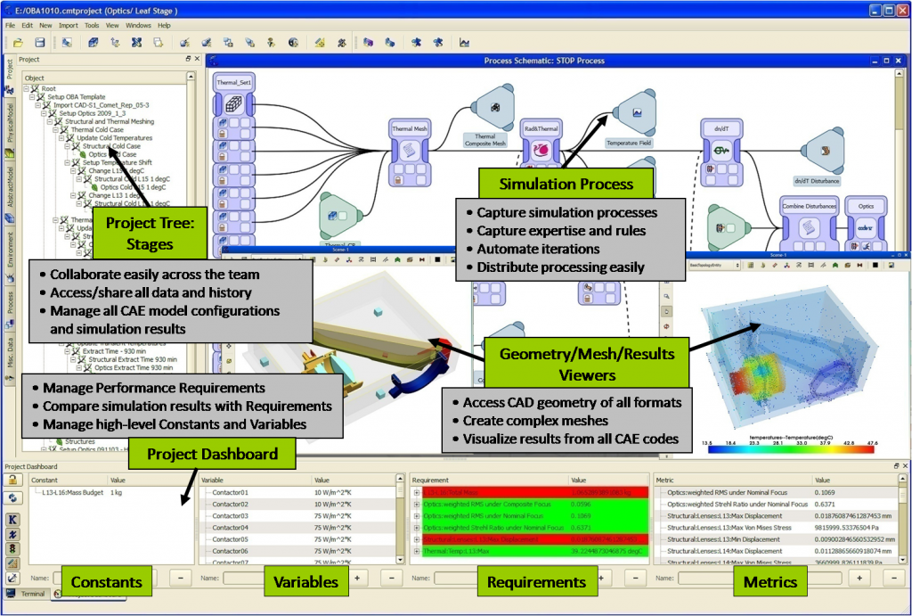
Example: Comet Workspace
Source: Comet Solutions, http://cometsolutions.com/products/workspace/

Slide 28
CoSimulation
For inseparable domains that require time synchronous solution
Each solver can run independently for a few (but different) steps, but meet regularly to synchronize
Requires transfer of variables/response between domains at synchronization points
May require iteration for equilibrium at synchronization points

Slide 29
CoSimulation Frameworks
Technology components (typical)
User interface
Executing sequence controller
Field mapper (surface, volumes, discrete data)
Client programs (solvers)
Libraries for communication, control, object creation, and data interpolation
API layer with language bindings eg Fortran 77, Fortran 90, C, and C+
Examples
Mesh-based parallel Code Coupling Interface (MpCCI)
SIMULIA Co-Simulation Engine (CSE)
Multi-Disciplinary Computing Environment (MDICE)
CSE Source: Blades, E.L., Miskovish, R.S., Luke, E.A., Collins, E.M., and Kurkchubashe, A.G., “A Multiphysics Simulation Capability using the SIMULIA Co-Simulation Engine,” Paper AIAA 2011-3397, 20th AIAA Computational Fluid Dynamics Conference, 27 - 30 June 2011, Honolulu, Hawaii
MDICE Source: Sheta, E.F., Siegel, J.M., Golos, F.N., and Harrand, V.J., “Twin-Tail Buffet Simulation Using a Multi-Disciplinary Computing Environment (MDICE),” CEAS/AIAA/ICASE/NASA Langley International Forum on Aeroelasticity and Structural Dynamics, Williamsburg, Virginia, USA, June 22-25, 1999
MpCCI Source: “MpCCI 4.0.1-4 Documentation,” Fraunhofer SCAI, http://www.mpcci.de/fileadmin/mpcci/download/MpCCI-4.0.1/doc/pdf/MpCCIdoc.pdf

Slide 30
Solution Process is the Key
For realistic complex problems (beyond serially separable and optimization), process knowledge is embedded in the solver executable.
Model data definition is not sufficient.
Case control, execution parameters are not sufficient.
For example, successful CFD requires complex numerical processes that are sensitive to the implementation expression.
As a result, co-simulation is required for the current multidisciplinary analyses of interest.

Slide 31
Workshop Organizer's Questions

Slide 32
What is your modeling approach?
For team building a single discipline model
Common COTS file formats or neutral file format
Detailed interface negotiation and documentation
Manual configuration control
For loosely coupled optimization or multi-disciplinary
Design models w/ solver to expose needed inputs and produce desired outputs
Provide a compact launchable executable
Manual configuration control, distill iterations into summary deliverable
For tightly coupled multi-disciplinary
Custom integrate to a co-simulation framework

Slide 33
How do you support the integrated modeling vision?
Rich legacy of serial or optimization style integrated examples
Steady progress in standards (AP209ed2) definition
Newly evolving co-simulation frameworks with generalized interface physics and variety of software process techniques
Growing adoption of simulation data management and codified processes

Slide 34
What are your integration challenges?
Wide variety of phenomena leads to complex physics and complex solver issues
Missing STEP AP209 translators from COTS vendors
Like systems engineering, multi-disciplinary modeling must cross organization boundaries to change existing practices with poorly documented business benefits
Data management is required infrastructure but suffers its own adoption challenges

Slide 35
How can MBSE help to address the challenges?
Continue formalizing modeling structure
Include STEP AP209 in STEP suite list
Lower cost of STEP implementations
Drive the business case
Pull disciplines into SE-led modeling in projects
Establish cross-society working groups

