Slide 1
Leading Process Transparency with BPMN Model Interchange
Boris G. Zinchenko, Ph.D.
Member of BPMN Model Interchange Working Group

Slide 2
Agenda
BPMN Modeling Standard
Sample of BPMN diagram
BPMN Interoperability Challenge
BPMN Model Interchange Format
Process Exchange with BPMN MI
BPMN MI Support by Vendors
Join Now! Be the Next!

Slide 3
Business Process Model and Notation
“A standard Business Process Model and Notation (BPMN) will provide businesses with the capability of understanding their internal business procedures in a graphical notation and will give organizations the ability to communicate these procedures in a standard manner. Furthermore, the graphical notation will facilitate the understanding of the performance collaborations and business transactions between the organizations. This will ensure that businesses will understand themselves and participants in their business and will enable organizations to adjust to new internal and B2B business circumstances quickly.”
http://www.bpmn.org/

Slide 4
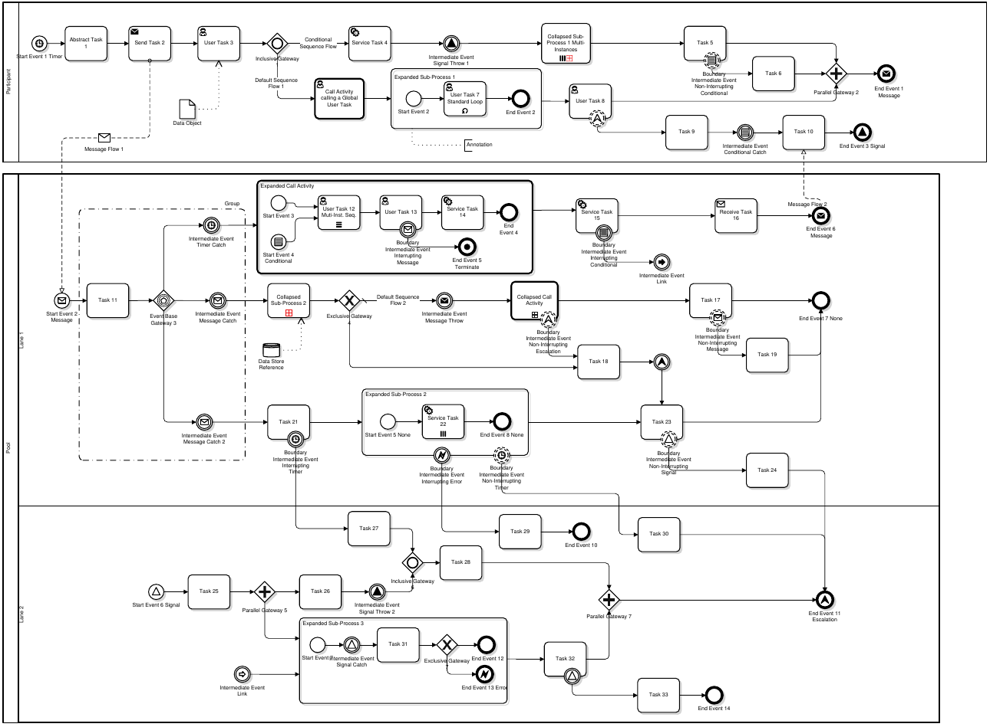
Example of BPMN diagram
This is an example of a BPMN reference diagram used in testing process of BPMN Model Interchange standard.
Diagram ID: B.2.0
https://github.com/bpmn-miwg/bpmn-miwg-test-suite/blob/master/Reference/B.2.0.png

Slide 5
BPMN Interoperability Challenge
“BPMN will provide a simple means of communicating process information to other business users, process implementers, customers, and suppliers.”
Business Process Model and Notation (BPMN), Version 2.0
http://www.omg.org/spec/BPMN/2.0
Problem: BPM models created in different tools are not interoperable with other tools and platforms
“The intent of BPMN is to standardize a business process model and notation in the face of many different modeling notations and viewpoints.”

Slide 6
BPMN Model Interchange Format
Business Process Model And Notation (BPMN) http://www.omg.org/spec/BPMN/2.0/
Standard XML representation of BPMN for interoperability between tools and vendors
BPMN Model Interchange Working Group (BPMN MIWG) established to support vendors http://www.omgwiki.org/bpmn-miwg/doku.php
Facilitate and demonstrate BPMN Model Interchange amongst tools
Define various test cases that address both breadth and depth of BPMN Model Interchange taking into consideration the various defined conformance classes of the BPMN standard
Resolve vendors’ misinterpretation of the specification that inhibit BPMN Interchange
Guide and support vendor into their implementations of the standard

Slide 7
Process exchange with BPMN MI
Model Interchange Procedure:
Draw BPMN model in a tool
Export model from a tool
Import model into another tool
Roundtrip interchange scenarios
Model transparency through interchange
BPMN XML
Tool 1
Tool 2
“The purpose of the BPMN MIWG is to support, facilitate, and promote the interchange of BPMN Models.”

Slide 8
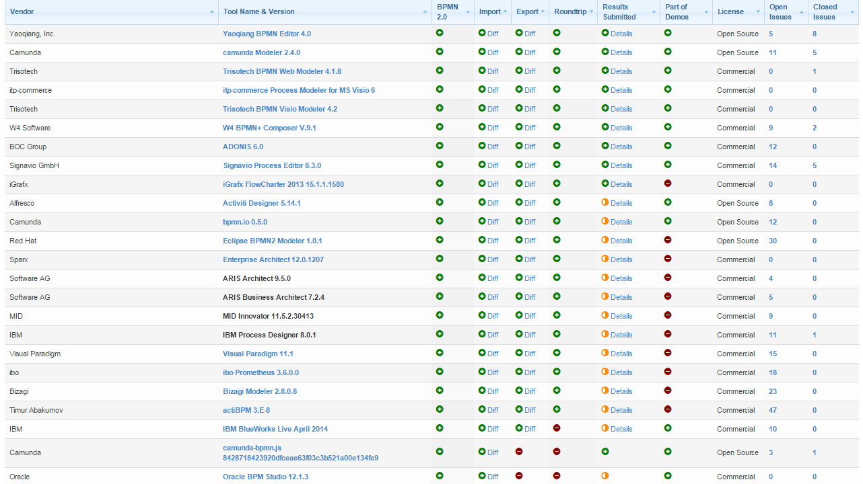
BPMN MIWG support by BPM vendors
http://bpmn-miwg.github.io/bpmn-miwg-tools/
Leading BPM vendors
Over 20 vendors
Growing community
Weekly meetings
BPMN 2.0 Test Cases (Models, Diagrams, Serializations)
Established test procedures
Demonstration Processes
Guidelines
Validation tools

Slide 9
Vendor support BPMN MI
Continued on the next slide…

Slide 10
Vendor support BPMN MI (continued)
Yaoqiang
More vendors to come…

Slide 11
Be the Next!
Join the growing community of BPMN Model Interchange vendors! Give a new mark of process transparency and collaboration to your clients with BPMN Model Interchange!

Slide 12
Boris G. Zinchenko, Ph.D.
Software Architect and Team Lead
Member of BPMN MIWG since 2013
Phone: +1 631 9544723 (USA)
+44 870 2957236 (EU)
Email: boris.zinchenko@gmail.com
Skype: bzinchenko
Thank you for your
time and attention!
The product names used in this document are for identification purposes only. All trademarks and registered trademarks are the property of their respective owners.

